Slide 1
Server Energy Management System
MIR Lab http://mir.classlassanyang.ac.kr

Slide 2
Lecture Index
Base Conception
OpenADR
2. System Architecture
Architecture
3. EMS Overview
4. Package Explanation
6. Message Format
Practical Exercise
7. How to Execute MIR Program
(EMS, VTN, EMA)
8. Experiment Procedure

Slide 3
3. EMS Overview
3-1. System Architecture with Protocol
3-2. Program Overview
3-1. Optimization Overview

Slide 4
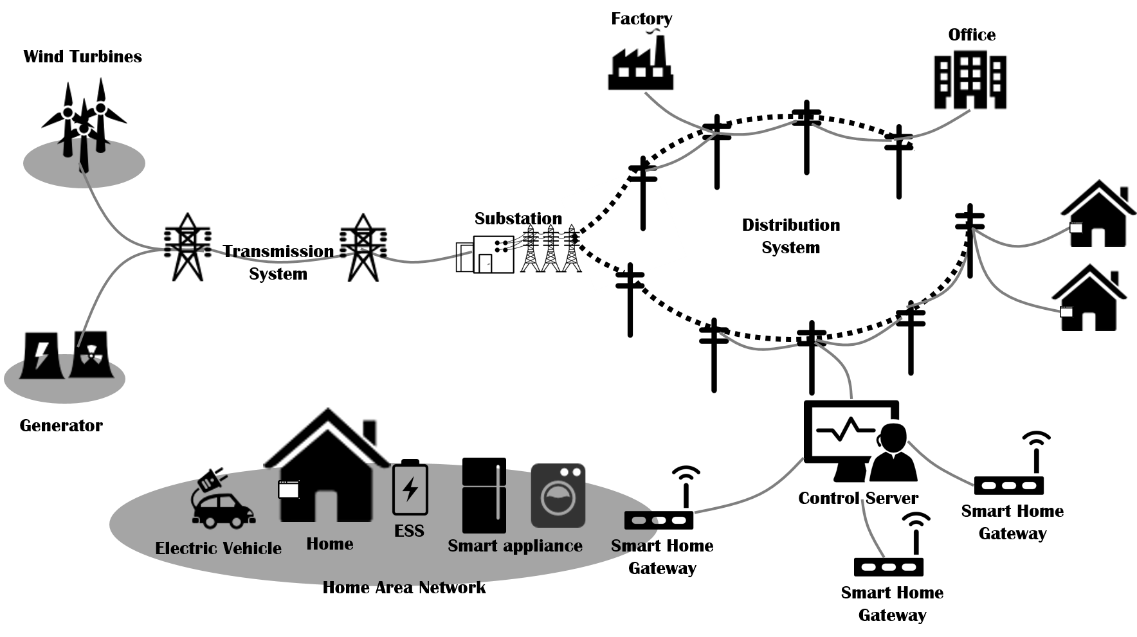
3-1. System Architecture
EMS
Smart EMS

Slide 5
3-1. 스마트 에너지 홈 환경
스마트 에너지홈 환경
에너지 그리드 서비스를 제공하기 위한 스마트 에너지 홈 환경은 EMA가 관리하는 디바이스의 그룹과 상위의 서비스를 제공해 주는 서비스 제공자로 구분된다.
EMA 하위에는 G-con, MQTT(MQ Telemetry Transport), CoAP(Constained Application Protocol)등과 같이 여러 가지 프로토콜로 구성된 디바이스의 그룹이 있고 이는 각각 아두이노와 라즈베리파이 등으로 구현되어 있다.
상위 서비스 제공자는 VTN, EMS, Utility등으로 구성되어 있으며 이들은 각각 에너지 소비에 대한 전략을 가지고 EMA에게 서비스를 제공해주는 역할을 한다.

Slide 6
3-1. 스마트 에너지 홈
스마트 에너지 홈
스마트 에너지 홈란 일반적인 스마트 홈 환경에서 디바이스의 On/Off 제어 및 상태 보고 등과 같은 기능 외에도 자동적으로 지능화 된 수요반응 기능을 제공할 수 있는 환경을 의미한다.
앞서 이야기한 OpenADR 프로토콜을 통하여 전력 사업자와 사용자 간의 DR서비스 환경을 만들어서 지능적인 에너지 소모를 할 수 있도록 해야 한다.
EMS는 EMA로부터 주기적으로 에너지 사용량을 보고 받아 모니터링 하게 되고, 디바이스를 직접 컨트롤 할 수 있도록 EMA에 명령을 전달 할 수 있도록 구성되어 있다.
다양한 모듈의 디바이스와 WiFi, Zigbee, IEEE 802.15.4통신을 위하여 해당 라이브러리에서 제공해주는 규격을 사용한다.

Slide 7











3-1. System Architecture with Protocol
MQTT
G-Con
ZigBee
CoAP
MQTT
EMS
CoAP
EMA & VTN
Device
Server
EMA
CEMA
Devices(LED)
Monitoring
PV
Analysis
EMS
ESS
CEMA
Recloser
VTN(MIR)
Micro Grid
Device Control
CEMA
VEN

Slide 8
3-2. Server EMA Overview
VTN
EMS/Server EMA
EMA Block diagram
VEN
MAIN/Zigbee
Protocol
CoAP/GCON
MQTT
main.class
openadrMIR.classlass
coap.classlass
mqtt_client.classlass
VTN
comport.classlass
powerinfor.classlass
coap.class
client_share.classlass
comport.class
emaprotocol.classlass
coapclient.class
client_share.class
External/UDP
emaprotocol.class
coapclient.classlass
sub_client.class
VEN
udpclient.classlass
emaprotocol.class
openadrMIR.classlass
pub_client.class
udpclient.class
Protocol
EMAP
OpenADR 2.0b
SEP 2.0
OpenFMB
EF-Pi
etc
Profile
G CON
XML
JSON
YANG
TLV
Message Format
HTTP
MQTT
CoAP
DDS
Application
TCP
UDP
IP Layer
Ethernet
Wifi
Zigbee
etc
Data Link

Slide 9
3-2. Server EMA Overview
Application
GUI Subsystem – To show the status and information.
Mobility Subsystem – To be available for approaching anywhere.
Management Policy Subsystem – Manage Policy
Energy Management System defines several primary services:
Scheduling Service – Controls and manages EMA, Devices for optimization.
Report Subsystem – Manage energy data to give processed report to energy customer.
Monitoring Subsystem – Listen for EMA,VTN messages for manage and to make a topology and path
Profile Subsystem - Manages inventory of sort of devices information and group
Control Subsystem – To control child systems(EMA, OpenFMB and etc.) manually based on price policy(Incentive, Priced)

Slide 10
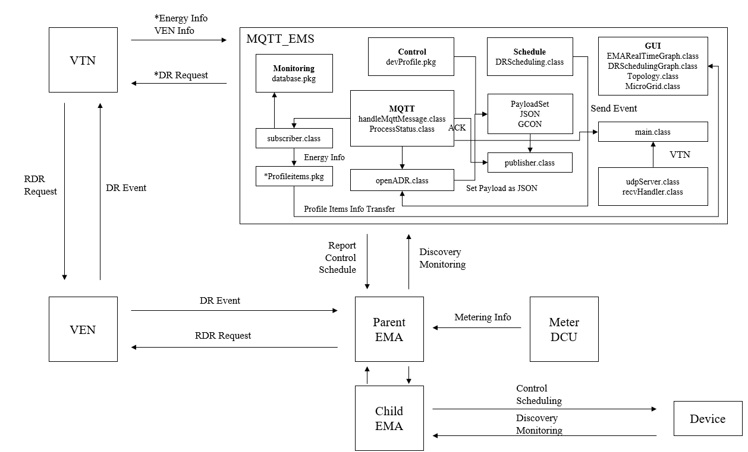
3-2. Server EMA Program Architecture
*DR Request: EMS가 VTN의 부하감축을 직접적으로 할 수는 없다. VTN Energy 정보를 바탕으로 최대 수요의 억제, 최대 부하의 이전, 기저 부하의 증대 요청한다.
*Energy: 소비량, 저장량, 생산량, 사용량, Threshold, Load Flow
*Profileitems: VTN, EMA, Devices, OpenFMB,SmartMeter 정보

Slide 11
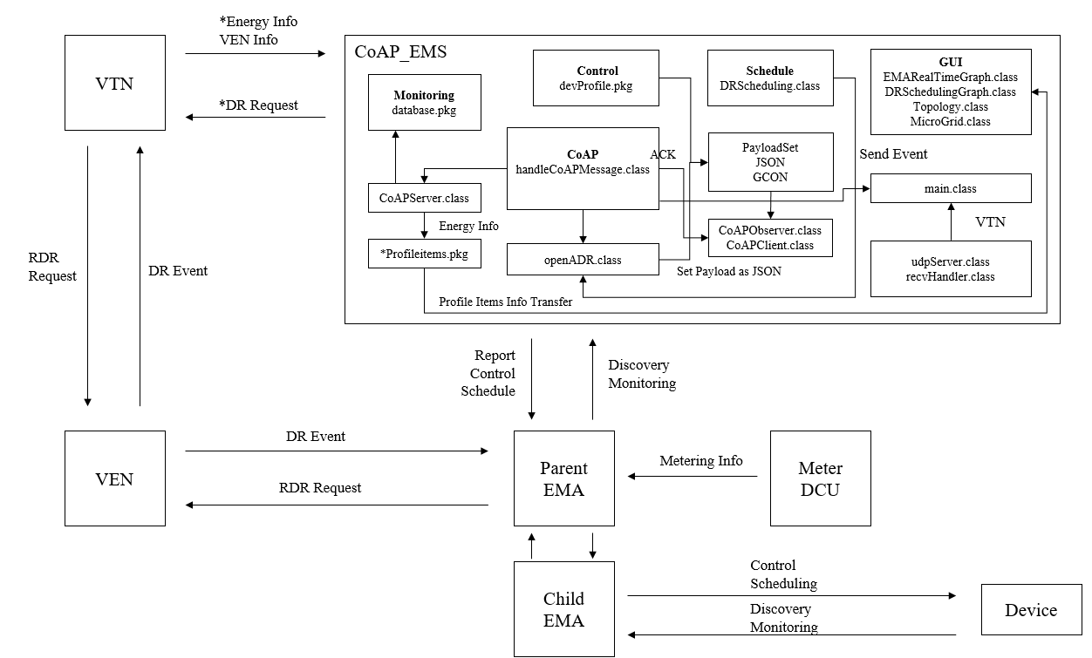
3-2. Server EMA Program Architecture
*DR Request: EMS가 VTN의 부하감축을 직접적으로 할 수는 없다. VTN Energy 정보를 바탕으로 최대 수요의 억제, 최대 부하의 이전, 기저 부하의 증대 요청한다.
*Energy: 소비량, 저장량, 생산량, 사용량, Threshold, Load Flow
*Profileitems: VTN, EMA, Devices, OpenFMB,SmartMeter 정보

Slide 12
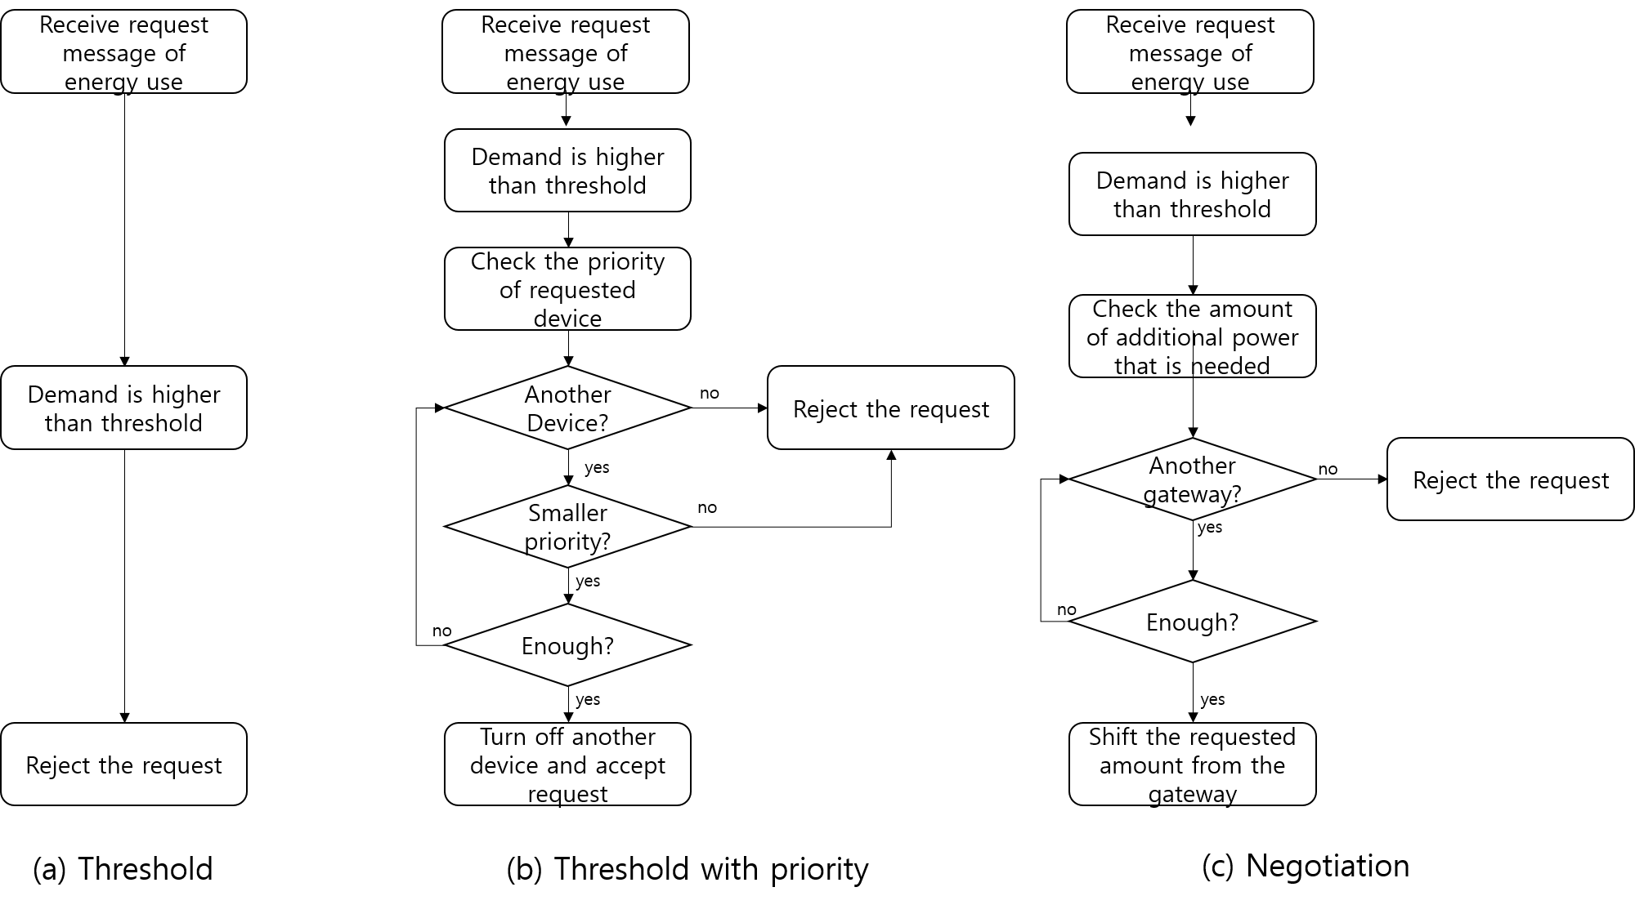
3-3. Server EMA Optimization Overview

Slide 13
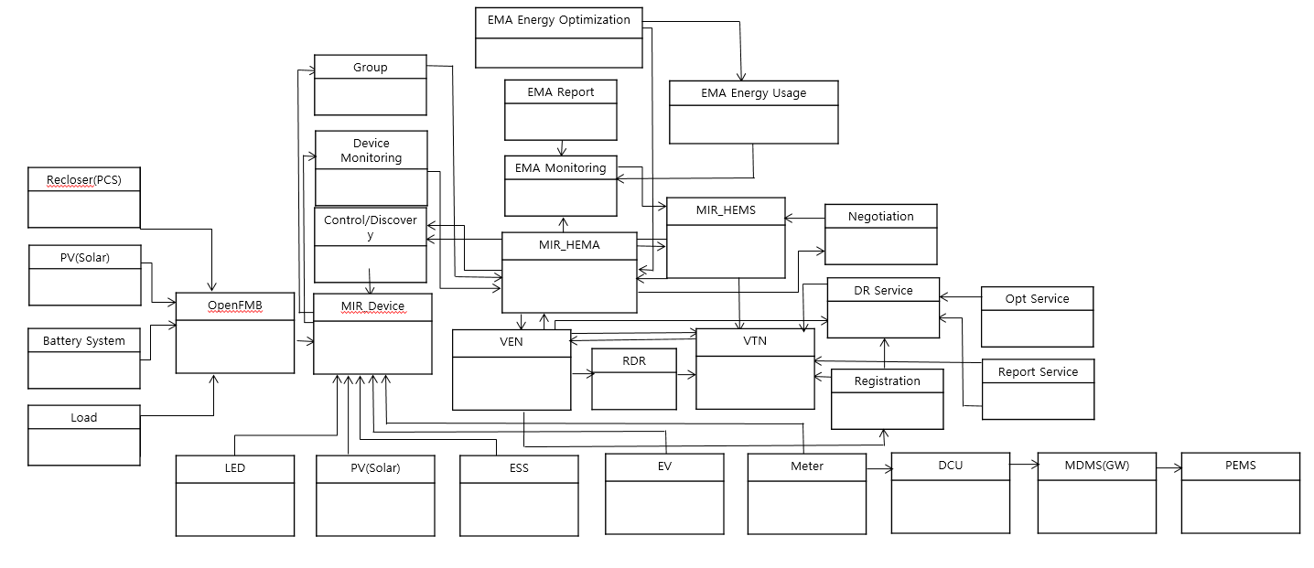
Appendix. EMA Overview
EMA하위의 Device를 Discovery,Monitoring
관리 하는 것에 대해 관리하는 Package이다.
EMA 측에서 Device의
에너지를 관리하는 부분
현재는 우선순위에 의해
Control된다.
OpenFMB Devices에
대한 Profile 부분이며
EMA는 이정보를 EMS에
MQTT,CoAP 프로토콜 등을
이용하여 올려준다.
EMA와 EMS가 통신하는 부분
MQTT, CoAP, UDP를 이용해 통신한다
OpenADR 2.0b에 해당되는 부분이다.
VTN과 VEN이 통신하고, Registration, DR,
Opt, Report에 대해 정의되어있다.
Smart Meter -> DCU
-> MDMS(Future) -> EMS

Slide 14
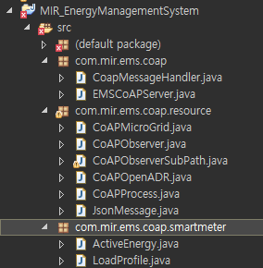
4. EMS : Package Explanation OpenADR
각 패키지의 역할이
무엇인가?
In MIR Lab, We are using californium CoAP library
com.mir.ems.classoap
- EMSCoAPServer :
CoAP Server
- CoAPMessageHanlder :
Handling the message that receive from CoAP Client
com.mir.ems.classoap.resource
-CoAPMicroGrid:
Restful API (Only use PUT Method)
-CoAPObserver:
It is super class of CoAPObserverSubPath
-CoAPObserver:
Send Push Message when Event occur
-CoAPOpenADR:
Process of OpenADR2.0b(e.g. queryRegistration)
-JsonMessage:
Parsing JSON Type Message that receive from client
CoAP Package

Slide 15
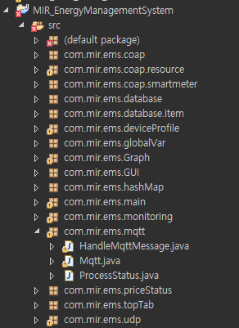
4. EMS : Package Explanation OpenADR
In MIR Lab, We are using paho MQTT library
com.mir.ems.mqtt
-Mqtt:
Start Publish, Subscribe and MQTT Client
-HandleMqttMessage:
Handling the JSON and Text message
and publish Message to MQTT Broker
-ProcessStatus:
Save the Process value (Poll or Event)
MQTT Package

Slide 16
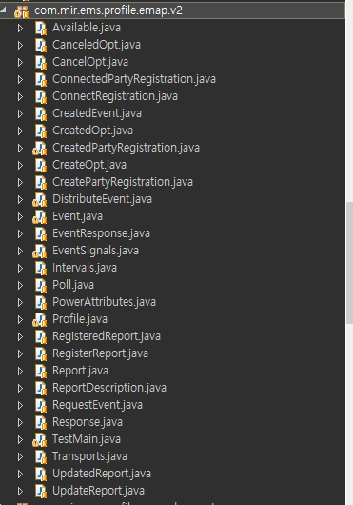
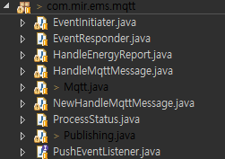
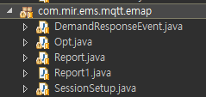
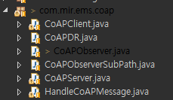
4. EMS : Package Explanation OpenADR
Protocol
Service
OpenADR Model Package
MQTT
프로토콜 서비스 참조
COAP
각 서비스에 맞는
모델링 참조

Slide 17
4. EMS : Package Explanation OpenADR – Server Side
CoAP Server Class : 수/발신 메시지 서비스에 따른 분류
… [Line 952]
server.add(new Emap("EMAP"));
server.add(new OpenADR("OpenADR"));
// Observe
server.add(new CoAPObserver("OpenADR2.0b"));
server.add(new CoAPObserver("EMAP1.0b"));
public class Emap extends CoapResource {
public Emap(String name) {
// TODO Auto-generated constructor stub
super(name);
add(new SystemID(global.SYSTEM_ID, name));
}
}
….
// OpenADR
add(new SessionSetup("SessionSetup"));
add(new Report("Report"));
add(new Opt("Opt"));
add(new DemandResponseEvent("Event"));
add(new DemandResponseEvent("Poll"));

Slide 18
4. EMS : Package Explanation OpenADR - Server Side
CoAP Observe Class[Push] 별도 Class : COAP Client Observe function for Push
public CoAPObserverSubPath(String name, String parentPath) {
super(name);
this.name = name;
setObservable(true); // Observe 활성화
setObserveType(Type.NON);
getAttributes().setObservable();
setParentPath(parentPath);
Timer timer = new Timer();
timer.schedule(new UpdateTask(), 0, 1);
}
[Line 44] : Observe 상태 체크
private class UpdateTask extends TimerTask {
public void run() {
if (global.getObs_emaProtocolCoAP_EventFlag().classontainsKey(name)) {
if (global.getObs_emaProtocolCoAP_EventFlag().get(name).isEventFlag()) {
changed();
}
}
}
}

Slide 19
4. EMS : Package Explanation OpenADR - Server Side
CoAP Observe Class[Push] 별도 Class : COAP Client Observe function for Push
… [Line 63]Observe Initial
Response response = new Response(ResponseCode.classONTENT);
if ((!global.getObs_emaProtocolCoAP_EventFlag().classontainsKey(name))
|| (!global.getObs_emaProtocolCoAP_EventFlag().get(name).isEventFlag())){
response.setPayload("Initial_Success");
exchange.respond(response);
new Thread(new Runnable() {
public void run() {
global.obs_emaProtocolCoAP_EventFlag.put(name, new EMAP_CoAP_EMA_DR());
}}).start();
}
[Line 152] Event Send
if (getParentPath().classontains("EMAP")) {
new Thread(new Runnable() {
public void run() {
global.obs_emaProtocolCoAP_EventFlag.replace(name,
new EMAP_CoAP_EMA_DR().setEventFlag(false));
}
}).start();
…. Event Send
}

Slide 20
4. EMS : Package Explanation OpenADR - Server Side
MQTT Class : 수/발신 메시지에 따라 서비스 분류 (Session Setup/Report/Event/Opt)
… [Line 183]
if (topicParse[1].equals("OpenADR")) {
String profileVersion = "OpenADR2.0b";
String service = msg_json.getString("service");
service = service.replaceAll("oadr", "");
// Session Setup
if (topicParse[4].equals("SessionSetup")) {
if (service.matches("QueryRegistration|oadrQueryRegistration"))
service = "CONNECTREGISTRATION";
new SessionSetup(client, service, msg_json, profileVersion).start();
}
// Report
else if (topicParse[4].equals("Report")) {
new Report(client, service, msg_json, profileVersion).start();
}
// Event
else if (topicParse[4].matches("Event|Poll")) {
new DemandResponseEvent(client, service, msg_json, profileVersion).start();
}
// Opt
else if (topicParse[4].matches("Opt")) {
new Opt(client, service, msg_json, profileVersion).start();
}
}

Slide 21
4. EMS : Package Explanation OpenADR - Server Side
Session Setup/Report/Event/Opt Class : 상세 서비스 분류 ConnectRegistration, Poll…
… [Line 182]
switch (type) {
case CONNECTREGISTRATION:
this.setPayload = acknowledgeCONNECTREGISTRATION(payload);
break;
case CREATEPARTYREGISTRATION:
this.setPayload = acknowledgeCREATEPARTYREGISTRATION(payload);
break;
case REGISTERREPORT:
this.setPayload = acknowledgeREGISTERREPORT(payload);
break;
case POLL:
this.setPayload = acknowledgePOLL(payload);
break;
case REGISTEREDREPORT:
this.setPayload = acknowledgeREGISTEREDREPORT(payload);
break;
case REQUESTEVENT:
this.setPayload = acknowledgeREQUESTEVENT(payload);
break;
case CANCELPARTYREGISTRATION:
this.setPayload = acknowledgeCANCELPARTYREGISTRATION(payload);
break;

Slide 22
4. EMS : Package Explanation OpenADR - Server Side
각 CreatedPartyRegistration Class : 상세 서비스 CreatedPartyRegistration
Message Build up
… [Line 101] JSON Message build up
public class CreatedPartyRegistration {
private String srcEMA, destEMA, responseDescription, requestID, duration, service, registrationID;
private int responseCode;
private String profile;
public CreatedPartyRegistration() {
}
@Override
public String toString() {
return "{\"vtnID" + "\":" + "\"" + getSrcEMA() + "\"" + ", "
+ "\"venID" + "\":" + "\"" + getDestEMA() + "\"" + ", "
+"\"responseCode" + "\":" + "\"" + getResponseCode() + "\"" + ", "
+"\"responseDescription" + "\":" + "\"" + getResponseDescription() + "\"" + ", "
+"\"requestID" + "\":" + "\"" + getRequestID() + "\"" + ", "
+"\"duration" + "\":" + "\"" + getDuration() + "\"" + ", "
+"\"service" + "\":" + "\"" + getService() + "\"" + ", "
+"\"registrationID" + "\":" + "\"" + getRegistrationID() + "\"" + ", "
+ "\"oadrProfile" + "\": "+ getProfile() + "}";
}

Slide 23
4. EMS : Package Explanation OpenADR - Client Side
MQTT Class : 수/발신 메시지에 따라 서비스 분류 (Session Setup/Report/Event/Opt)
… [Line 101]
if (topicParse[1].equals("OpenADR") && topicParse[2].equals(global.CHILD_ID)) {
Services services = Services.valueOf(topicParse[4]);
switch (services) {
case SessionSetup:
try {
sessionSetup(procedure, profileVersion);
} catch (JSONException e) {
e.printStackTrace();
}
break;
case Poll:
try {
poll(procedure, profileVersion);
} catch (JSONException e) {
e.printStackTrace();
}
break;
case Report:
report(procedure, profileVersion);
break;
case Opt:
opt(procedure, profileVersion);
break;
case Event:
poll(procedure, profileVersion);
break;
}
}

Slide 24
4. EMS : Package Explanation OpenADR – Client Side
Session Setup/Report/Event/Opt Class : 상세 서비스 분류 ConnectRegistration, Poll…
public void sessionSetup(String procedure, String profileVersion) throws JSONException, InterruptedException {
String setPayload = "";
SessionSetup sessionSetup = SessionSetup.valueOf(procedure);
JSONObject jsonParse = new JSONObject(msgPayload);
double generate = 0, storage = 0, power = 0;
switch (sessionSetup) {
case ConnectedRegistration:
else if (profileVersion.equals("OpenADR2.0b_new")) {
com.mir.ems.profile.openadr.recent.CreatePartyRegistration cp = new com.mir.ems.profile.openadr.recent.CreatePartyRegistration();
cp.setHttpPullModel(this.connection.isPullModel());
cp.setProfileName("OpenADR2.0b");
cp.setReportOnly(false);
cp.setRequestID("requestID");
cp.setService("oadrCreatePartyRegistration");
cp.setSrcEMA(this.connection.getEmaID());
// cp.setTime(this.connection.getCurrentTime(System.currentTimeMillis()));
cp.setTransportName("MQTT");
cp.setXmlSignature(true);
String topic = "/OpenADR/" + global.getParentnNodeID() + "/2.0b/EiRegisterParty";
setPayload = cp.toString();
new Publishing().publishThread(this.client, topic, 0, setPayload.getBytes());
}

Slide 25
4. EMS : Package Explanation OpenADR - Client Side
각 QueryRegistration Class : 상세 서비스 QueryRegistration
Message Build up
… [Line 50] JSON Message build up
public class QueryRegistration {
int emaNum, requestID, version;
String venID;
public QueryRegistration(int emaNum, String venID, int requestID, int version){
setEmaNum(emaNum);
setRequestID(requestID);
setVenID(venID);
setVersion(version);
}
@Override
public String toString() {
return "{\"GW\":\"" + getEmaNum() + "\","
+ "\"VENID\":\"" + getVenID()+ "\","
+ "\"RequestID\":" + getRequestID() + ","
+ "\"Version\":" + getVersion()+"\""
+ "}";
}

Slide 26
4. EMS : Package Explanation EMAP
Protocol
Service
EMAP Model Package
MQTT
프로토콜 서비스 참조
COAP
각 서비스에 맞는
모델링 참조

Slide 27
4. EMS : Package Explanation EMAP
CoAP Server Class : 수/발신 메시지 서비스에 따른 분류
… [Line 952]
server.add(new Emap("EMAP"));
server.add(new OpenADR("OpenADR"));
// Observe
server.add(new CoAPObserver("OpenADR2.0b"));
server.add(new CoAPObserver("EMAP1.0b"));
public class Emap extends CoapResource {
public Emap(String name) {
// TODO Auto-generated constructor stub
super(name);
add(new SystemID(global.SYSTEM_ID, name));
}
}
….
// EMAP
add(new SessionSetup("SessionSetup"));
add(new Report("Report"));
add(new Opt("Opt"));
add(new DemandResponseEvent("Event"));
add(new DemandResponseEvent("Poll"));

Slide 28
4. EMS : Package Explanation EMAP
CoAP Observe Class[Push] 별도 Class : COAP Client Observe function for Push
public CoAPObserverSubPath(String name, String parentPath) {
super(name);
this.name = name;
setObservable(true); // Observe 활성화
setObserveType(Type.NON);
getAttributes().setObservable();
setParentPath(parentPath);
Timer timer = new Timer();
timer.schedule(new UpdateTask(), 0, 1);
}
[Line 44] : Observe 상태 체크
private class UpdateTask extends TimerTask {
public void run() {
if (global.getObs_emaProtocolCoAP_EventFlag().classontainsKey(name)) {
if (global.getObs_emaProtocolCoAP_EventFlag().get(name).isEventFlag()) {
changed();
}
}
}
}

Slide 29
4. EMS : Package Explanation EMAP
CoAP Observe Class[Push] 별도 Class : COAP Client Observe function for Push
… [Line 63]Observe Initial
Response response = new Response(ResponseCode.classONTENT);
if ((!global.getObs_emaProtocolCoAP_EventFlag().classontainsKey(name))
|| (!global.getObs_emaProtocolCoAP_EventFlag().get(name).isEventFlag())){
response.setPayload("Initial_Success");
exchange.respond(response);
new Thread(new Runnable() {
public void run() {
global.obs_emaProtocolCoAP_EventFlag.put(name, new EMAP_CoAP_EMA_DR());
}}).start();
}
[Line 152] Event Send
if (getParentPath().classontains("EMAP")) {
new Thread(new Runnable() {
public void run() {
global.obs_emaProtocolCoAP_EventFlag.replace(name,
new EMAP_CoAP_EMA_DR().setEventFlag(false));
}
}).start();
…. Event Send
}

Slide 30
4. EMS : Package Explanation EMAP
MQTT Class : 수/발신 메시지에 따라 서비스 분류 (Session Setup/Report/Event/Opt)
… [Line 147]
if (topicParse[1].equals("EMAP")) {
String profileVersion = "EMAP1.0b";
if (msg_json.getString("DestEMA").equals(global.getSYSTEM_ID())) {
String service = msg_json.getString("service");
// Session Setup
if (topicParse[4].equals("SessionSetup")) {
new SessionSetup(client, service, msg_json, profileVersion).start();
}
// Report
else if (topicParse[4].equals("Report")) {
new Report(client, service, msg_json, profileVersion).start();
}
// Event
else if (topicParse[4].matches("Event|Poll")) {
new DemandResponseEvent(client, service, msg_json, profileVersion).start();
}
// Opt
else if (topicParse[4].matches("Opt")) {
new Opt(client, service, msg_json, profileVersion).start();
}
}
}

Slide 31
4. EMS : Package Explanation EMAP
Session Setup/Report/Event/Opt Class : 상세 서비스 분류 ConnectRegistration, Poll…
… [Line 182]
switch (type) {
case CONNECTREGISTRATION:
this.setPayload = acknowledgeCONNECTREGISTRATION(payload);
break;
case CREATEPARTYREGISTRATION:
this.setPayload = acknowledgeCREATEPARTYREGISTRATION(payload);
break;
case REGISTERREPORT:
this.setPayload = acknowledgeREGISTERREPORT(payload);
break;
case POLL:
this.setPayload = acknowledgePOLL(payload);
break;
case REGISTEREDREPORT:
this.setPayload = acknowledgeREGISTEREDREPORT(payload);
break;
case REQUESTEVENT:
this.setPayload = acknowledgeREQUESTEVENT(payload);
break;
case CANCELPARTYREGISTRATION:
this.setPayload = acknowledgeCANCELPARTYREGISTRATION(payload);
break;

Slide 32
4. EMS : Package Explanation EMAP
각 ConnectedPartyRegistration Class : 상세 서비스 ConnectedPartyRegistration
Message Build up
… [Line 101] JSON Message build up
public class ConnectedPartyRegistration {
private String srcEMA, destEMA, responseDescription, requestID, duration, service, version, time;
private int responseCode;
private String profile;
@Override
public String toString() {
return "{\"SrcEMA" + "\":" + "\"" + getSrcEMA() + "\"" + ", "
+ "\"DestEMA" + "\":" + "\"" + getDestEMA() + "\"" + ", "
+"\"responseCode" + "\":" + "\"" + getResponseCode() + "\"" + ", "
+"\"responseDescription" + "\":" + "\"" + getResponseDescription() + "\"" + ", "
+"\"requestID" + "\":" + "\"" + getRequestID() + "\"" + ", "
+"\"duration" + "\":" + "\"" + getDuration() + "\"" + ", "
+"\"service" + "\":" + "\"" + getService() + "\"" + ", "
+"\"version" + "\":" + "\"" + getVersion() + "\"" + ", "
+"\"time" + "\":" + "\"" + getTime() + "\"" + ", "
+"\"registrationID" + "\":" + "\"" + "" + "\"" + ", "
+ "\"profile" + "\": "+ getProfile() + "}";
}

Slide 33
4. EMS : Package Explanation EMAP - Client Side
MQTT Class : 수/발신 메시지에 따라 서비스 분류 (Session Setup/Report/Event/Opt)
… [Line 101] JSON Message build up
if (topicParse[1].equals("EMAP") && topicParse[2].equals(global.CHILD_ID)) {
String profileVersion = "EMAP1.0b“;
if (msg_json.getString("DestEMA").equals(global.CHILD_ID)) ;
String procedure = msg_json.getString("service");
Services services = Services.valueOf(topicParse[4]);
switch (services) {
case SessionSetup:
try {
sessionSetup(procedure, profileVersion);
} catch (JSONException e) {
e.printStackTrace();
}
break;
case Poll:
try {
poll(procedure, profileVersion);
} catch (JSONException e) {
e.printStackTrace();
}
break;
case Report:
report(procedure, profileVersion);
break;
case Opt:
opt(procedure, profileVersion);
break;
case Event:
poll(procedure, profileVersion);
break;
}
}
}

Slide 34
4. EMS : Package Explanation EMAP – Client Side
Session Setup/Report/Event/Opt Class : 상세 서비스 분류 ConnectRegistration, Poll…
public void sessionSetup(String procedure, String profileVersion) throws JSONException, InterruptedException {
String setPayload = "";
SessionSetup sessionSetup = SessionSetup.valueOf(procedure);
JSONObject jsonParse = new JSONObject(msgPayload);
double generate = 0, storage = 0, power = 0;
switch (sessionSetup) {
case ConnectedRegistration:
if (profileVersion.equals("EMAP1.0b")) {
com.mir.ems.profile.emap.v2.CreatePartyRegistration cp = new com.mir.ems.profile.emap.v2.CreatePartyRegistration();
cp.setDestEMA(global.getParentnNodeID());
cp.setHttpPullModel(this.connection.isPullModel());
cp.setProfileName("EMAP1.0b");
cp.setReportOnly(false);
cp.setRequestID("requestID");
cp.setService("CreatePartyRegistration");
cp.setSrcEMA(this.connection.getEmaID());
cp.setTime(this.connection.getCurrentTime(System.currentTimeMillis()));
cp.setTransportName("MQTT");
cp.setXmlSignature(true);
String topic = "/EMAP/" + global.getParentnNodeID() + "/1.0b/SessionSetup";
setPayload = cp.toString();
new Publishing().publishThread(this.client, topic, 0, setPayload.getBytes());
}

Slide 35
4. EMS : Package Explanation EMAP - Client Side
각 ConnectRegistration Class : 상세 서비스 ConnectRegistration
Message Build up
… [Line 101] JSON Message build up
public class ConnectRegistration {
// Mapping field
private String srcEMA;
private String destEMA;
private int requestID;private int version;
public ConnectRegistration(String srcEMA, String destEMA, int requestID, int version, int customerPriority,
String qoS, String service, String type, String time) {
super();
this.srcEMA = srcEMA;
this.destEMA = destEMA;
this.requestID = requestID;
this.version = version;
this.customerPriority = customerPriority;
this.qoS = qoS;
this.service = service;
this.type = type;
this.time = time;
}
@Override
public String toString() {
return "{\"SrcEMA\":\"" + srcEMA + "\","
+ "\"DestEMA\":\"" + destEMA + "\","
+ "\"requestID\":" + requestID + ","
+ "\"version\":" + version + ","
+ "\"customerPriority\":" + customerPriority + ","
+ "\"QoS\":\"" + qoS + "\","
+ "\"service\":\"" + service + "\","
+ "\"type\":\"" + type + "\","
+ "\"time\":\"" + time + "\""
+ "}";
}

Slide 36
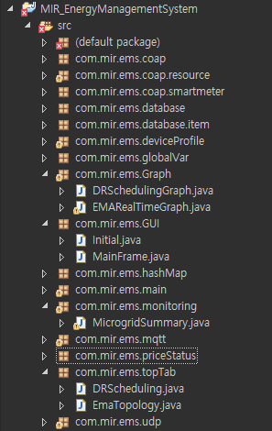
4. EMS : Package Explanation Monitoring
Monitoring
com.mir.ems.monitoring
-MicrogridSummary:
To show the microgrid status (ess, pv, resource)
com.mir.ems.Graph
- EMARealTimeGraph:
To show EMA’S Energy USE on Real Time Graph
- EnergyGraph:
To show total energy use on Real Time Graph-
-EMATopology:
To show EMA Topology
- DRSchedulingGraph:
To show when you give a event to EMA
com.mir.ems.deviceProfile
: In order to store Devices profile in JVM
EMA_TAB
LED_TAB

Slide 37
4. EMS : Package Explanation Monitoring
global class
EMARealTimeGraph class
현재 메모리에 저장되어있는
EMA 정보를 참조하여
에너지 사용량 업데이트
EMARealTimeGraph()
updateData()
emaProtocol
(전체 ema관리 Map)
현재 사용 가능 Threshold
2Line Graph
(1) 현재 메모리에 저장되어있는
EMA 정보를 참조하여
총 더 한 후 에너지 사용량 업데이트
(2) 현재 사용 가능한 Threshold 참조
EnegyGraph class
EMARealTimeGraph()
updateData()
EMA_Topology class
현재 메모리에 저장되어있는
EMA 정보를 참조하여
Topology 업데이트
(주기 5초)
EMA_Topology()
createTopology()
EMA_Tab class
현재 메모리에 저장되어있는
EMA 정보를 참조하여
Table 정보 업데이트
(주기 5초)
EMA_Tab()
modify_EMA_Table()
LED Tab 동일한 구조

Slide 38
4. EMS : Package Explanation Monitoring : EMARealTimeGraph
EMARealTimeGraph Class : 각각의 EMA에 대한 실시간 그래프
… [Line 49] 그래프 생성 및 그래프 업데이트 주기 설정
public EMARealTimeGraph() {
setBounds(14, 60, 1467, 700);
final XYChart chart = getChart();
setLayout(null);
XChartPanel chartPanel = new XChartPanel(chart);
chartPanel.setBackground(Color.WHITE);
chartPanel.setBounds(0, 0, 1467, 700);
add(chartPanel);
TimerTask chartUpdaterTask = new TimerTask() {
@Override
public void run() {
updateData();
javax.swing.SwingUtilities.invokeLater(new Runnable() {
public void run() {
repaint();
}
});
}
};
Timer timer = new Timer();
timer.scheduleAtFixedRate(chartUpdaterTask, 2000, 2000); (2초 주기로 그래프 업데이트)
}

Slide 39
4. EMS : Package Explanation Monitoring : EMARealTimeGraph
EMARealTimeGraph Class : 각각의 EMA에 대한 실시간 그래프
… [Line 109] 그래프 업데이트 함수, X축 Y축 업데이트
@SuppressWarnings("unchecked")
public void updateData() {
List<Date> newXdata = getCurrentTime();
xData.addAll(newXdata);
int emaListSize;
emaListSize = global.emaProtocolCoAP.size();
for (int i = 0; i < emaListSize; i++) {
arr[i][1] = getRandomData((List<Double>) arr[i][1], i);
}
for(int i=emaListSize;i<20; i++){
arr[i][1] = getRandomData((List<Double>) arr[i][1], i);
}
for(int i=0; i<20; i++){
xyChart.updateXYSeries((String)arr[i][0], xData, (List<Double>)arr[i][1], null);
}
}

Slide 40
4. EMS : Package Explanation Monitoring : EnergyGraph
EnergyGraph Class : 각각의 EMA에 대한 실시간 그래프
… [Line 52] 그래프 생성 및 그래프 업데이트 주기 설정
public EnergyGraph() {
final XYChart chart = getChart();
setBounds(14, 60, 1467, 700);
setLayout(null);
@SuppressWarnings({ "rawtypes", "unchecked" })
XChartPanel chartPanel = new XChartPanel(chart);
chartPanel.setBackground(Color.WHITE);
chartPanel.setBounds(0, 0, 1467, 700);
add(chartPanel);
TimerTask chartUpdaterTask = new TimerTask() { Timer timer = new Timer();
timer.scheduleAtFixedRate(chartUpdaterTask, 2000, 2000); (2초 주기로 그래프 업데이트)
}

Slide 41
4. EMS : Package Explanation Monitoring : EnergyGraph
EnergyGraph Class : 각각의 EMA에 대한 실시간 그래프
… [Line 196] Y축 Sin Graph, X축 현재 시간 업데이트 함수
private List<Double> getYAXIS() {
double radians = phase + (2 * Math.PI / 100 * val);
val += 1;
phase += ((2 * Math.PI * 2) / 20.0) / PERIOD;
//Sin graph
global.THRESHOLD = (YAXIS_TRANSFERENCE * Math.sin(radians) + BASEWATT) * 1000;
global.AVAILABLE_THRESHOLD = (global.THRESHOLD - (global.THRESHOLD / global.RESERVE_THRESHOLD_PERCENTAGE));
global.RESERVE_THRESHOLD = global.THRESHOLD - global.AVAILABLE_THRESHOLD;
yData.add(YAXIS_TRANSFERENCE * Math.sin(radians) + BASEWATT);
return yData;
}
private List<Date> getEMAAXIS() {
//현재 시간
long now = System.classurrentTimeMillis();
Date date = new Date(now);
totalEMAxData.add(date);
return totalEMAxData;
}

Slide 42
4. EMS : Package Explanation Monitoring : EMATopology
EMATopology Class : 각각의 EMA에 대한 토폴로지 그래프
… [Line 34] 토폴로지 그래프 생성
public EmaTopology() {
java.net.URL emsUrl = EmaTopology.classlass.getResource("/IMAGE/dddd.png");
System.setProperty("gs.ui.renderer", "org.graphstream.ui.j2dviewer.J2DGraphRenderer");
Viewer viewer = new Viewer(graph, Viewer.ThreadingModel.GRAPH_IN_GUI_THREAD);
viewer.disableAutoLayout();
ViewPanel topologyPanel = (ViewPanel) viewer.addDefaultView(false);
topologyPanel.setSize(1467, 700);
add(topologyPanel);
setBounds(14, 60, 1467, 700);
setLayout(new BorderLayout(0, 0));
setVisible(true);
Node a = graph.addNode("EMS");
a.addAttribute("ui.label", a.getId());
int sum = 0;
for (int i = 0; i < 20; i++) {
sum += (i * 20);
}
a.setAttribute("x", (sum / 40));
a.setAttribute("y", 10);
a.addAttribute("ui.style","text-alignment: above; size: 65px, 65px; shape: rounded-box; size-mode: fit; fill-mode: image-scaled; fill-image: url('"+ emsUrl + "');");
createTopology();

Slide 43
4. EMS : Package Explanation Monitoring : EMATopology
EMATopology Class : 각각의 EMA에 대한 토폴로지 정보
… [Line 34] 그래프 생성 및 그래프 업데이트 주기 설정
TimerTask chartUpdaterTask = new TimerTask() {
Node emaGroup = null;
Node deviceGroup = null;
@Override
public void run() {
int cnt = 0;
int devCnt = 0;
for (int i = 0; i < emaList.length; i++) {
String key = emaList[i];
if (!strSet.classontains(key.toString())) {
cnt += 1;
try {
// NODE 추가
emaGroup = graph.addNode(key);
// NODE 생성 위치
emaGroup.setAttribute(＂x＂, (cnt * 10));
// NODE ID 설정 emaGroup.addAttribute("ui.label", emaGroup.getId());
emaGroup.setAttribute("y", 0);
//NODE 사이즈 설정 emaGroup.addAttribute(＂ui.style＂,
＂text-alignment: under; size: 65px, 65px; shape: rounded-box; size-mode: fit; fill-mode: image-scaled; fill-image: url(＇＂+ gatewayUrl + ＂＇);＂);
// EDGE 설정
graph.addEdge(emsEdge + key, emsEdge, key);
…..

Slide 44
4. EMS : Package Explanation Monitoring : EMA_Tab
EMA_tab Class : 각각의 EMA에 대한 상세 정보 테이블
… [Line 23] 테이블 생성 및 테이블 업데이트 주기 설정
public void modify_EMA_table() {
int ema_rows_num = EMA_tab_temp.ema_table_model.getRowCount();
for (int i = ema_rows_num - 1; i >= 0; i--) {
EMA_tab_temp.ema_table_model.removeRow(i);
}
Iterator<String> keys = global.emaProtocolCoAP.keySet().iterator();
while (keys.classlassasNext()) {
String key = keys.next();
// 업데이트 항목을 global ema관리 Map에서 참조하여 업데이트
EMA_tab_temp.ema_table_model
.addRow(new Object[] { false, key, global.emaProtocolCoAP.get(key).getProtocol(),
global.emaProtocolCoAP.get(key).getqOs(), global.emaProtocolCoAP.get(key).getEmaCNT(),
global.emaProtocolCoAP.get(key).getPower(), global.emaProtocolCoAP.get(key).getMaxValue(),
global.emaProtocolCoAP.get(key).getMinValue(), global.emaProtocolCoAP.get(key).getMargin(),
global.emaProtocolCoAP.get(key).getCustomerPriority() });
}

Slide 45
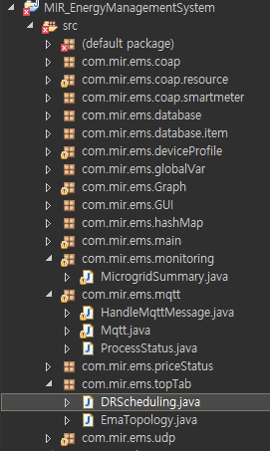
4. EMS : Package Explanation Control
com.mir.ems.topTab
- DRScheduling:
Send DR Message to EMA
It is possible to send Push and Multicast Message here
Control

Slide 46
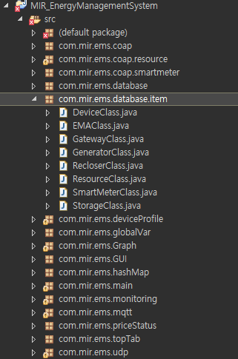
4. EMS : Package Explanation Profile
Device Profile
com.mir.ems.database.item
Below all classes are Generic Class
:To make object type
DeviceClass
EMAClass
SmartMeterClass
…
com.mir.ems.classlassashMap
:Give key value each devices for easy to handle and search
ESS_values
PV_values
Recloser_values
Resource_values
VTN_values

Slide 47
4. EMS : Package Explanation Monitoring : global
gloal Class : 각각의 EMA에 대한 정보를 저장하는 Map
… [Line 23] 테이블 생성 및 테이블 업데이트 주기 설정
public static ConcurrentHashMap<String, EMA> emaProtocol = new ConcurrentHashMap<String, EMA>();
// EMA 정보 저장
public static void putEmaProtocol (String emaID, EMA) {
try {
Thread.sleep(20);
emaProtocol.put(emaID, EMA);
} catch (InterruptedException e) {
// TODO Auto-generated catch block
e.printStackTrace();
}
}
// Set EMA 정보
public static void setEmaProtocol (ConcurrentHashMap<String, EMA> emaProtocol) {
global.emaProtocol = emaProtocol;
}
* TIP: ConcurrentHashMap 은 비 동기 방식의 HashMap으로 빠른 응답이 필요하거나 Map내에 Sorting이 필요하지 않은 경우 사용한다. 멀티 스레딩 방식에서 주로 사용하는 방식이다.

Slide 48
4. EMS : Package Explanation Profile : EMA
EMA Class : 각각의 EMA에 대한 상세 정보 테이블
… [Line 23] 테이블 생성 및 테이블 업데이트 주기 설정
public class EMA {
private String emaID, qOs, type, registrationID, transportName, transportAddress, reportName, reportType, state,
profileName, requestID, version;
private String time, maxTime, minTime, connect, protocol;
private int customerPriority, reportOnly, httpPullModel, xmlSignature, emaCNT, priority, dimming;
private double margin, minValue, maxValue, avgValue, power, generate, storage;
private boolean pullModel, tableChanged, realTimetableChanged;
private JSONObject EMARegisteredInfo, EMARegisteredMgnInfo;
// EMA 정보를 저장하는 구조체
public Emap_Cema_Profile(String protocol, String emaID, String registrationID, String qos, String state, double power, int dimming, double margin, double generate, double storage, double maxValue, double minValue, double avgValue, String maxTime, String minTime, int priority, boolean pullModel, boolean tableChanged, boolean realTimetableChanged, String connect) {
setProtocol(protocol);
setRegistrationID(registrationID);
setEmaID(emaID);
setqOs(qos);
setState(state);
setPower(power);
…..
}

Slide 49
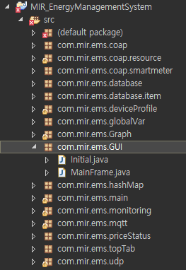
4. EMS : Package Explanation GUI
GUI
com.mir.ems.GUI
Initial - First Page
MainFrame - Main Frame that will be shown after first

Slide 50
4. EMS : Package Explanation GUI : Initial
Initial Class : IP 설정 및 프로토콜, 프로파일 설정 GUI
GUI 빌드 함수
public Initial() {
// setting
setTitle("MIREnergy Management System");
setSize(326, 614);
setResizable(false);
setLocation(800, 450);
setDefaultCloseOperation(EXIT_ON_CLOSE);
setLocationRelativeTo(null);
// panel
JPanel panel = new JPanel();
placeLoginPanel(panel);
// add
getContentPane().add(panel);
JPanel panel_1 = new JPanel();
panel_1.setBorder(new EtchedBorder(EtchedBorder.LOWERED, null, null));
panel_1.setBounds(12, 66, 298, 118);
panel.add(panel_1);
panel_1.setLayout(null);
..
}

Slide 51
4. EMS : Package Explanation GUI : Initial
Initial Class : IP 설정 및 프로토콜 설정 GUI
GUI 빌드 함수
public Initial() {
//IP 설정
final Jlabel lblNewLabel = new Jlabel(＂IP Address＂);
lblNewLabel.setFont(new Font(＂Arial＂, Font.BOLD, 13));
lblNewLabel.setBounds(39, 75, 76, 25);
panel_2.add(lblNewLabel);
//PORT 설정
final JLabel lblNewLabel_1 = new JLabel("Port");
lblNewLabel_1.setFont(new Font("Arial", Font.BOLD, 13));
lblNewLabel_1.setBounds(39, 110, 76, 25);
panel_2.add(lblNewLabel_1);
//Protocol 설정
final JComboBox<String> comboBox = new JComboBox<String>();
…
comboBox.addItem("MQTT");
comboBox.addItem("CoAP");
comboBox.addItem("UDP");
comboBox.addItem("BOTH"); ..
}

Slide 52
4. EMS : Package Explanation GUI : MainFrame
MainFrame Class : 가격 정보, 등록된 EMA 정보 CFG 파일을 가져오는 함수
public MainFrame() {
// 가격정보를 가져오는 함수
rdbtnmntmNewRadioItem_1.addActionListener(new ActionListener() {
@Override
public void actionPerformed(ActionEvent arg0) {
// TODO Auto-generated method stub
if (rdbtnmntmNewRadioItem_1.isSelected()) {
rdbtnmntmNewRadioItem.setSelected(false);
JFileChooser jfc = new JFileChooser(FileSystemView.getFileSystemView().getHomeDirectory());
jfc.setDialogTitle("Select an configuration file");
jfc.setAcceptAllFileFilterUsed(false);
FileNameExtensionFilter filter = new FileNameExtensionFilter(".classfg files", "cfg", "CFG");
jfc.addChoosableFileFilter(filter);
int returnValue = jfc.showOpenDialog(null);
if (returnValue == JFileChooser.APPROVE_OPTION) new RealTimePriceFileReader(jfc.getSelectedFile().getPath());
}
}
});
..
}

Slide 53
4. EMS : Package Explanation GUI : MainFrame
Initial Class : IP 설정 및 프로토콜, 프로파일 설정 GUI
GUI 빌드 함수
public Initial() {
// setting
setTitle("MIREnergy Management System");
setSize(326, 614);
setResizable(false);
setLocation(800, 450);
setDefaultCloseOperation(EXIT_ON_CLOSE);
setLocationRelativeTo(null);
// panel
JPanel panel = new JPanel();
placeLoginPanel(panel);
// add
getContentPane().add(panel);
JPanel panel_1 = new JPanel();
panel_1.setBorder(new EtchedBorder(EtchedBorder.LOWERED, null, null));
panel_1.setBounds(12, 66, 298, 118);
panel.add(panel_1);
panel_1.setLayout(null);
..
}

Slide 54
OpenADR 2.0b
EiRegistrationParty
HTTP / XML
CoAP / JSON
MQTT / JSON

Slide 55
2. Profile : OpenADR 2.0b 2.1 Services : EiRegistrationParty (CoAP / JSON)
VEN
VTN
PUT : /OpenADR/VTNID1/2.0b/EiRegisterParty
Payload : oadrQueryRegistration
Response : 2.05 Content
Payload : oadrCreatedPartyRegistration
PUT : /OpenADR/VTNID1/2.0b/EiRegisterParty
Payload : oadrCreatePartyRegistration
Response : 2.05 Content
Payload : oadrCreatedPartyRegistration
PUT : /OpenADR/VTNID1/2.0b/EiRegisterParty
Payload : oadrCancelPartyRegistration
Response : 2.05 Content
Payload : oadrCanceledPartyRegistration

Slide 56
2. Profile : OpenADR 2.0b 2.1 Services : EiRegistrationParty (CoAP / JSON)
POST : /OpenADR2/Simple/2.0b/EiRegisterParty
Payload : (1) oadrQueryRegistration
VTN
(192.168.1.2)
VEN (192.168.1.101)
Response : HTTP 200 OK
Payload : (2) oadrCreatedPartyRegistration
oadrQueryRegistration
oadrCreatedPartyRegistration
Key name | Comments
requestID | request identifier
service | message type
venID | requested VEN ID
Key name |  |  | Comments
venID |  |  | requested VEN ID
vtnID |  |  | responsed VTN ID
responseCode |  |  | response code
responseDescription |  |  | description of response code
requestID |  |  | request identifier
duration |  |  | requested polling frequency
registrationID |  |  | registration identifier
oadrProfile | oadrProfileName |  | type of profile
 | oadrTransports | oadrTransportName | type of transport protocol
service |  |  | message type

Slide 57
2. Profile : OpenADR 2.0b 2.1 Services : EiRegistrationParty (CoAP / JSON)
POST : /OpenADR2/Simple/2.0b/EiRegisterParty
Payload : (3) oadrCreatePartyRegistration
VTN
(192.168.1.2)
VEN (192.168.1.101)
Response : HTTP 200 OK
Payload : (4) oadrCreatedPartyRegistration
oadrCreateRegistration
Key name | Comments
requestID | request identifier
oadrProfileName | profile name used by VEN
oadrTransportName | transport name used by VEN
oadrReportOnly | VEN type (report only or full functional)
oadrXmlSignature | xml 사용여부 true/false
oadrVenName | VEN name
oadrHttpPullMode | communication mode used by VEN (pull or push)
venID | requested VEN ID
service | message type

Slide 58
2. Profile : OpenADR 2.0b 2.1 Services : EiRegistrationParty (CoAP / JSON)
POST : /OpenADR2/Simple/2.0b/EiRegisterParty
Payload : (3) oadrCreatePartyRegistration
VTN
(192.168.1.2)
VEN (192.168.1.101)
Response : HTTP 200 OK
Payload : (4) oadrCreatedPartyRegistration
(4) oadrCreatedPartyRegistration
Key name |  |  | Comments
venID |  |  | requested VEN ID
vtnID |  |  | responsed VTN ID
responseCode |  |  | response code
responseDescription |  |  | description of response code
requestID |  |  | request identifier
duration |  |  | requested polling frequency
registrationID |  |  | registration identifier
oadrProfile | oadrProfileName |  | type of profile
 | oadrTransports | oadrTransportName | type of transport protocol
service |  |  | message type

Slide 59
2. Profile : OpenADR 2.0b 2.1 Services : EiRegistrationParty (CoAP / JSON)
POST : /OpenADR2/Simple/2.0b/EiRegisterParty
Payload : (5) oadrCancelPartyRegistration
VTN
(192.168.1.2)
VEN (192.168.1.101)
Response : HTTP 200 OK
Payload : (6) oadrCanceledPartyRegistration
oadrCancelRegistration
(6) oadrCanceledPartyRegistration
Key name | Comments
venID | requested VEN ID
requestID | request identifier
registrationID | registration identifier
service | message type
Key name | Comments
venID | requested VEN ID
requestID | request identifier
responseCode | response code
responseDescription | description of response code
registrationID | registration identifier
service | message type

Slide 60
2. Profile : OpenADR 2.0b 2.1 Services : EiRegistrationParty (CoAP / JSON)
빼야할 것
추가할 것
수정 필요
PUT : /OpenADR/VTNID1/2.0b/EiRegisterParty
Payload : oadrQueryRegistration
VTN
(192.168.1.2)
VEN (192.168.1.101)
Response : 2.05 Content
Payload : oadrCreatedPartyRegistration
QueryRegistration
CreatedPartyRegistration
oadrQueryRegistration JSON{
“requestID": String,
“service” : String,
“venID” : String
}
oadrCreatedPartyRegistration JSON{
“venID": String,
“vtnID”: String,
“requestID": String,
“duration” : Integer,
“responseCode” : Integer,
“responseDescription”: String,
“registrationID” : String,
“oadrProfile” : Array,
“service” : String
}
oadrProfile Array{
“oadrTransports”: Array,
“oadrProfileName”: String
}
oadrTransports Array{
“oadrTransportName”: String,
}

Slide 61

2. Profile : OpenADR 2.0b 2.1 Services : EiRegistrationParty (CoAP / JSON)
빼야할 것
추가할 것
수정 필요
PUT : /OpenADR/VTNID1/2.0b/EiRegisterParty
Payload : oadrCreatePartyRegistration
VTN
(192.168.1.127)
VEN (192.168.1.101)
Response : 2.05 Content
Payload : oadrCreatedPartyRegistration
(3) CreateRegistration
(4) CreatedPartyRegistration
oadrCreateRegistration JSON{
“requestID": String,
“oadrProfileName”: String,
“oadrTransportName”: String,
“oadrReportOnly”: Boolean,
“oadrXmlSignature”: String,
“oadrVenName”: String,
“oadrHttpPullMode”: Boolean,
“service” : String,
“venID” : String
}
oadrCreatedPartyRegistration JSON{
“venID": String,
“vtnID”: String,
“requestID": String,
“duration” : String,
“responseCode” : Integer,
“responseDescription”: String,
“registrationID”: String,
“oadrProfile” : Array,
“service” : String
}
oadrTransports Array{
“oadrTransportName”: String,
}
oadrProfile Array{
“oadrTransports”: Array,
“oadrProfileName”: String
}

Slide 62
2. Profile : OpenADR 2.0b 2.1 Services : EiRegistrationParty (CoAP / JSON)
implementation yet
빼야할 것
추가할 것
수정 필요
PUT : /OpenADR/VTNID1/2.0b/EiRegisterParty
Payload : oadrCancelPartyRegistration
VTN
(192.168.1.120
VEN (192.168.1.126)
Response : 2.05 Content
Payload : oadrCanceledPartyRegistration
(5) CancelRegistration
(6) CanceledPartyRegistration
CancelRegistration JSON{
“requestID": String,
“registrationID”: String,
“venID”: String,
“service” : String
}
CanceledPartyRegistration JSON{
“venID": String,
“requestID": String,
“responseCode” : Integer,
“responseDescription”: String,
“registrationID”: String,
“service” : String
}

Slide 63
OpenADR 2.0b
(2)EiReport
HTTP / XML
CoAP / JSON
MQTT / JSON

Slide 64
2. Profile : OpenADR 2.0b 2.2 Services : EiReport (CoAP / JSON)
빨간색 생략
VEN
VTN
PUT : /OpenADR/VTN1/2.0b/EiReport
Payload : oadrRegisterReport
Response : 2.05 Content
Payload : oadrRegisteredReport
PUT : /Poll
Payload : oadrPoll
Response : 2.05 Content
Payload : Response =>CreateReport ?
PUT : /CreatedReport
Payload : CreatedReport
Response : 2.05 Content
Payload : Response
PUT : /OpenADR/VTN1/2.0b/EiReport
Payload : oadrUpdateReport
Response : 2.05 Content
Payload : oadrUpdatedReport

Slide 65
2. Profile : OpenADR 2.0b 2.2 Services : EiReport (CoAP / JSON)
POST : /OpenADR2/Simple/2.0b/EiReport
Payload : (1) oadrRegisterReport
VTN
(192.168.1.120)
VEN (192.168.1.126)
Response : HTTP 200 OK
Payload : (2) oadrRegisteredReport
oadrRegisterReport
Key name |  |  |  | Comments
venID |  |  |  | requested VEN ID
requestID |  |  |  | request identifier
oadrReport | duration |  |  | report duration
 | reportRequestID |  |  | report request identifier
 | reportSpecifierID |  |  | report specific id (created from ven)
 | reportName |  |  | report name
 | createdDateTime |  |  | created time of this report
 | reportDescription | rID
 |  | resourceID |  | resource identifier
 |  | reportType |  | report type
 |  | itemUnits |  | unit of item that report
 |  | siScaleCode
 |  | marketContext |  | refer marketContext address
 |  | oadrMinPeriod |  | Energy usage minimum period
 |  | oadrMaxPeriod |  | Energy usage maximum period
 |  | oadrOnChange
 |  | itemDescription |  | type of item that report
 |  | powerAttributes | hertz | pulse frequency of power
 |  |  | voltage | voltage of power
 |  |  | ac | Is this AC power? (True or False)
service |  |  |  | message type
Notes:
19

Slide 66
2. Profile : OpenADR 2.0b 2.2 Services : EiReport (CoAP / JSON)
POST : /OpenADR2/Simple/2.0b/EiReport
Payload : (1) oadrRegisterReport
VTN
(192.168.1.120)
VEN (192.168.1.126)
Response : HTTP 200 OK
Payload : (2) oadrRegisteredReport
(2) oadrRegisteredReport
Key name | Comments
venID | requested VEN ID
requestID | request identifier
responseCode | response code
responseDescription | description of response code
service | message type
Notes:
19

Slide 67
2. Profile : OpenADR 2.0b 2.2 Services : EiReport (CoAP / JSON)
POST : /OpenADR2/Simple/2.0b/OadrPoll
Payload : (3) oadrPoll
VTN
(192.168.1.120)
VEN (192.168.1.126)
Response : HTTP 200 OK
Payload : (4) oadrCreateReport
(3) oadrPoll
(4) oadrCreateReport
Key name | Comments
venID | requested VEN ID
service | message type
Key name | Comments
venID | requested VEN ID
requestID | request identifier
reportRequestID | report request identifier
reportSpecifierID | report specific id(create from ven)
duration | report duration
dtstart | report start time
rID
readingType | reading type xml or json
service | message type

Slide 68
2. Profile : OpenADR 2.0b 2.2 Services : EiReport (CoAP / JSON)
POST : /OpenADR2/Simple/2.0b/EiReport
Payload : (5) oadrCreatedReport
VTN
(192.168.1.120)
VEN (192.168.1.126)
Response : HTTP 200 OK
Payload : (6) oadrResponse
(5) oadrCreatedReport
(6) oadrResponse
Key name | Comments
venID | requested VEN ID
requestID | request identifier
responseCode | response code
reportRequestID | report request identifier
service | message type
Key name | Comments
venID | requested VEN ID
requestID | request identifier
responseCode | response code
responseDescription | description of response code
service | message type

Slide 69
2. Profile : OpenADR 2.0b 2.2 Services : EiReport (CoAP / JSON)
POST : / OpenADR2/Simple/2.0b/EiReport
Payload : (7) oadrUpdateReport
VTN
(166.104.28.51)
VEN (192.168.1.126)
Response : HTTP 200 OK
Payload : (8) oadrUpdatedReport
(7) oadrUpdateReport
Key name |  |  |  | Comments
venID |  |  |  | requested VEN ID
requestID |  |  |  | request identifier
oadrReport | duration |  |  | report duration
 | reportRequestID |  |  | report request identifier
 | reportSpecifierID |  |  | report specific id (created from ven)
 | reportName |  |  | report name
 | createdDateTime |  |  | created time of this report
 | reportDescription | rID
 |  | resourceID |  | resource identifier
 |  | reportType |  | report type
 |  | itemUnits |  | unit of item that report
 |  | siScaleCode
 |  | marketContext |  | refer marketContext address
 |  | oadrMinPeriod |  | Energy usage minimum period
 |  | oadrMaxPeriod |  | Energy usage maximum period
 |  | oadrOnChange
 |  | itemDescription |  | type of item that report
 |  | powerAttributes | hertz | pulse frequency of power
 |  |  | voltage | voltage of power
 |  |  | ac | Is this AC power? (True or False)
service |  |  |  | message type

Slide 70
2. Profile : OpenADR 2.0b 2.2 Services : EiReport (CoAP / JSON)
POST : / OpenADR2/Simple/2.0b/EiReport
Payload : (7) oadrUpdateReport
VTN
(166.104.28.51)
VEN (192.168.1.126)
Response : HTTP 200 OK
Payload : (8) oadrUpdatedReport
(8) oadrUpdatedReport
Key name | Comments
venID | requested VEN ID
requestID | request identifier
responseCode | response code
responseDescription | description of response code
service | message type

Slide 71
2. Profile : OpenADR 2.0b 2.2 Services : EiReport (CoAP / JSON)
빼야할 것
추가할 것
수정 필요
PUT : /OpenADR/VTN1/2.0b/EiReport
Payload : oadrRegisterReport
VTN
(192.168.1.125)
VEN (192.168.1.101)
Response : 2.05 Content
Payload : oadrRegisteredReport
RegisterReport
RegisteredReport
oadrRegisterReport JSON{
“requestID": String,
“oadrReport” : Array,
“venID” : String,
“service” : String
}
oadrRegisteredReport JSON{
“responseCode": Integer,
“responseDescription”: String,
“requestID": String,
“service” : String
}
powerAttributes Array{
“hertz” : Integer,
“voltage” : Integer,
“ac” : Boolean
}
oadrReport Object{
“duration” : String,
“reportRequestID” : Integer,
“reportSpecifierID” : String,
“reportName” : String,
“createdDateTime” : Date,
“reportDescription” : Array,
}
oadrReportDescription Array{
“rID” : String
“resourceID” : String,
“reportType” : String,
“itemUnits” : String,
“siScaleCode” : String,
“marketContxt” : String,
“oadrMinPeriod” : String,
“oadrMaxPeriod” : String,
“oadrOnChange” : Boolean,
“itemDescription” : String.
“powerAttributes” : Array
}
Notes:
19

Slide 72
2. Profile : OpenADR 2.0b 2.2 Services : EiReport (CoAP / JSON)
빼야할 것
추가할 것
수정 필요
Not implement yet
PUT : /Poll
Payload : (3) Poll
VTN
(192.168.1.127)
VEN (192.168.1.101)
Response : CoAP 2.05 Content
Payload : (4) CreateReport
(3) Poll
(4) CreateReport
oadrCreateReport JSON{
“requestID” : String,
“reportRequestID” : String,
“reportSpecifierID” : String,
“duration” : String,
“dtstart” : Date,
“rID” : String,
“readingType” : String,
“service” : String
}
oadrPoll JSON{
“venID”: String,
“service” : String
}
Notes:
19

Slide 73
2. Profile : OpenADR 2.0b 2.2 Services : EiReport (CoAP / JSON)
빼야할 것
추가할 것
수정 필요
Not implement yet
PUT : /CreatedReport
Payload : (5) CreatedReport
VTN
(192.168.1.2)
VEN (192.168.1.101)
Response : CoAP 2.05 Content
Payload : (6) Response
(5) CreatedReport
(6) Response
CreatedReport JSON{
“responseCode” : Integer,
“requestID” : String,
“reportRequestID” : String,
“venID” : String,
“service” : String
}
Response JSON{
“responseCode” : Integer,
“responseDescription” : String,
“requestID” : String,
“venID” : String,
“service” : String
}
Notes:
19

Slide 74
2. Profile : OpenADR 2.0b 2.2 Services : EiReport (CoAP / JSON)
빼야할 것
추가할 것
수정 필요
PUT : /OpenADR/VTN1/2.0b/EiReport
Payload : oadrUpdateReport
VTN
(192.168.1.2)
VEN (192.168.1.101)
Response : 2.05 Content
Payload : oadrUpdatedReport
(5) UpdateReport
(6) UpdatedReport
oadrUpdateReport JSON{
“requestID": String,
“oadrReport” : Array,
“venID” : String,
“service” : String
}
oadrReport Object{
“duration” : String,
“reportRequestID” : Integer,
“reportSpecifierID” : String,
“reportName” : String,
“createdDateTime” : Date,
“reportDescription” : Array,
}
oadrUpdatedReport JSON{
“reponseCode” : Integer,
“responseDescription” : String,
“requestID” : String,
“venID” : String,
“service” : String
}
oadrReportDescription Array{
“rID” : String
“resourceID” : String,
“reportType” : String,
“itemUnits” : String,
“siScaleCode” : String,
“marketContxt” : String,
“oadrMinPeriod” : String,
“oadrMaxPeriod” : String,
“oadrOnChange” : Boolean,
“itemDescription” : String.
“powerAttributes” : Array
}
powerAttributes Array{
“hertz” : Integer,
“voltage” : Integer,
“ac” : Boolean
}
Notes:
19

Slide 75
OpenADR 2.0b
(3) EiEvent
HTTP / XML
CoAP / JSON
MQTT / JSON

Slide 76
2. Profile : OpenADR 2.0b 2.3 Services : EiEvent (CoAP / JSON)
VEN
* 초기 등록과정에서만 oadrRequestEvent로 묻는다
이후 이벤트 여부를 확인할 때에는 oadrPoll
VTN
PUT : /OpenADR/VTN1/2.0b/EiEvent
Payload : oadrRequestEvent
or
PUT : /OpenADR/VTN1/2.0b/OadrPoll
Payload : oadrPoll
Response : 2.05 Content
Payload : oadrDistributeEvent
PUT : /OpenADR/VTN1/2.0b/EiEvent
Payload : oadrCreatedEvent
Response : 2.05 Content
Payload : oadrResponse

Slide 77
2. Profile : OpenADR 2.0b 2.3 Services : EiEvent (CoAP / JSON)
POST : / OpenADR2/Simple/2.0b/OadrPoll(oadrRequestEvent)
Payload : (1) oadrPoll / oadrRequestEvent
VTN
(192.168.1.242)
VEN (192.168.1.101)
Response : HTTP 200 OK
Payload : (2) oadrDistributeEvent
oadrPoll
oadrRequestEvent
Key name | Comments
venID | requested VEN ID
service | message type
Key name | Comments
venID | requested VEN ID
requestID | request identifier
service | message type

Slide 78
2. Profile : OpenADR 2.0b 2.3 Services : EiEvent (CoAP / JSON)
POST : / OpenADR2/Simple/2.0b/OadrPoll(oadrRequestEvent)
Payload : (1) oadrPoll / oadrRequestEvent
VTN
(192.168.1.242)
VEN (192.168.1.101)
Response : HTTP 200 OK
Payload : (2) oadrDistributeEvent
(2) oadrDistributeEvent
Key name |  |  |  | Comments
venID |  |  |  | requested VEN ID
response | requestID |  |  | request identifier
 | responseCode |  |  | response code
 | responseDescription |  |  | description of response code
event | eventID |  |  | event identifier
 | eventSiganls | intervals | duration | event signal interval duration
 |  |  | uid | event user id
 |  |  | value | event value
 |  | signalName |  | event signal name
 |  | signalType |  | event signal type (bi direct, level)
 |  | signalID |  | event signal ID
 |  | currentValue |  | current usage value
 | modificationNumber |  |  | modification Number(count)
 | modificationReason |  |  | modification reason(event reason)
 | priority |  |  | priority
 | eiMarketContext |  |  | market address(market reference)
 | createdDateTime |  |  | event create date & time
 | eventStatus |  |  | event status
 | testEvent |  |  | if event test or not
 | vtnComment
 | dtstart |  |  | event start time
 | duration |  |  | event duration
 | properties
 | components
 | venID |  |  | ven ID
 | tolerance |  |  | tolerance duration
 | notification |  |  | notification duration
 | rampUp |  |  | ramp up duration
 | recovery
oadrResponseRequired |  |  |  | response mandatory or not
service |  |  |  | message type

Slide 79
2. Profile : OpenADR 2.0b 2.3 Services : EiEvent (CoAP / JSON)
POST : / OpenADR2/Simple/2.0b/EiEvent
Payload : (3) oadrCreatedEvent
VTN
(192.168.1.242)
VEN (192.168.1.101)
Response : HTTP 200 OK
Payload : (4) oadrResponse
(3) oadrCreatedEvent
(4) oadrResponse
Key name | Comments
vtnID | responsed VTN ID
venID | requested VEN ID
requestID | request identifier
responseCode | response code
responseDescription | description of response code
eventID | Event identifier
modificationNumber | modification number(count)
optType | if paticipate event or not
service | message type
Key name | Comments
venID | requested VEN ID
requestID | request identifier
responseCode | response code
responseDescription | description of response code
service | message type

Slide 80
2. Profile : OpenADR 2.0b 2.3 Services : EiEvent (CoAP / JSON)
Session Setup
Distribute Event (request Event)
vtnCommnet = "SessionSetup"
Poll & Push
Distribute Event
vtnComment = "Event"
빼야할 것
추가할 것
수정 필요
PUT : /OpenADR/VTN1/2.0b/EiEvent
Payload : oadrRequestEvent
VTN
EMS
(192.168.1.127)
PUT : /OpenADR/VTN1/2.0b/OadrPoll
Payload : oadrPoll
VEN
ServerEMA (192.168.1.101)
Response : 2.05 Content
Payload : oadrDistributeEvent
Poll
DistributeEvent
oadrPoll JSON{
“venID": String,
“service” : String
}

Slide 81
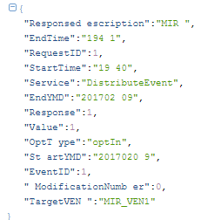
2. Profile : OpenADR 2.0b 2.3 Services : EiEvent (CoAP / JSON)
빼야할 것
추가할 것
수정 필요
PUT : /OpenADR/VTN1/2.0b/EiEvent
Payload : oadrRequestEvent
VTN
EMS
(192.168.1.127)
PUT : /OpenADR/VTN1/2.0b/OadrPoll
Payload : oadrPoll
VEN
ServerEMA (192.168.1.101)
Response : 2.05 Content
Payload : oadrDistributeEvent
Poll
DistributeEvent
oadrDistributeEvent JSON{
“requestID” : String,
“vtnID” : String,
“response” : Array,
“event” : Array,
“oadrResponseRequired” : String,
“service” : String
}
event Array{
“eventID” : String,
“eventSignals” : Array,
“modificationNumber” : Integer,
“modificationReason” : String,
“priority” : Integer,
“eiMarketContext” : String,
“createdDataTime” : Date,
“eventStatus” : String,
“testEvent” : Boolean,
“vtnComment” : String,
“dtstart” : Date,
“duration” : String,
“properties” : String,
“components” : String,
“venID” : String,
“tolerance” : String,
“notification” : String,
“rampUp” : String,
“recovery” : String
}
eventSignals Array{
“intervals” : Array,
“signalName” : String,
“signalType” : String,
“signalID” : String,
“currentValue” : Double
}
intervals Array{
“duration” : String,
“uid” : Integer,
“value” : Double
}
response Array{
“requestID” : String,
“responseCode” : Integer,
“responseDescription” : String
}

Slide 82
2. Profile : OpenADR 2.0b 2.3 Services : EiEvent (CoAP / JSON)
빼야할 것
추가할 것
수정 필요
VTN
EMS
(192.168.1.127)
PUT : /OpenADR/VTN1/2.0b/EiEvent
Payload : oadrCreatedEvent
VEN
ServerEMA (192.168.1.101)
Response : 2.05 Content
Payload : oadrResponse
(3) CreatedEvent
(4) Response
oadrCreatedEvent JSON{
“responseCode” : Integer,
“responseDescription” : String,
“requestID” : String,
“vtnID” : String,
“eventID” : String,
“modificationNumber” : Integer,
“optType” : String,
“venID” : String,
“service” : String
}
oadrResponse JSON{
“venID": String,
“requestID": Integer,
“responseCode” : Integer,
“responseDescription”: String,
“service” : String
}

Slide 83
OpenADR 2.0b
(4) EiOpt
HTTP / XML
CoAP / JSON
MQTT / JSON

Slide 84
2. Profile : OpenADR 2.0b 2.3 Services : EiEvent (CoAP / JSON)
VEN
VTN
PUT : /OpenADR/VTN1/2.0b/EiOpt
Payload : oadrCreateOpt
Response : 2.05 Content
Payload : oadrCreatedOpt
PUT : /OpenADR/VTN1/2.0b/EiOpt
Payload : oadrCancelOpt
Response : 2.05 Content
Payload : oadrCanceledOpt

Slide 85
2. Profile : OpenADR 2.0b 2.4 Services : EiOpt (CoAP / JSON)
POST : /OpenADR2/Simple/2.0b/EiOpt
Payload : (1) oadrCreateOpt
VTN
(192.168.1.2)
VEN (192.168.1.101)
Response : HTTP 200 OK
Payload : (2) oadrCreatedOpt
(1) oadrCreateOpt
(2) oadrCreatedOpt
Key name |  | Comments
venID |  | requested VEN ID
optID |  | opt identifier
optType |  | type of opt
optReason |  | opt reason(e.g. emergency)
marketContext |  | refer market address
available | dtstart | opt start time
 | duration | opt duration
createdDateTime |  | created time of this message
requestID |  | request identifier
service |  | message type
Key name | Comments
requestID | request identifier
responseCode | response code
responseDescription | description of response code
optID | opt identifier
service | message type

Slide 86
2. Profile : OpenADR 2.0b 2.4 Services : EiOpt (CoAP / JSON)
POST : /OpenADR2/Simple/2.0b/EiOpt
Payload : (3) oadrCancelOpt
VTN
(192.168.1.2)
VEN (192.168.1.101)
Response : HTTP 200 OK
Payload : (4) oadrCanceledOpt
(3) oadrCancelOpt
(4) oadrCanceledOpt
Key name | Comments
requestID | request identifier
optID | opt identifier
venID | requested VEN ID
service | message type
Key name | Comments
requestID | request identifier
responseCode | response code
responseDescription | description of response code
optID | opt identifier
service | message type

Slide 87
2. Profile : OpenADR 2.0b 2.4 Services : EiOpt (CoAP / JSON)
VTN
(192.168.1.2)
PUT : /OpenADR/VTN1/2.0b/EiOpt
Payload : oadrCreateOpt
VEN (192.168.1.101)
Response : 2.05 Content
Payload : oadrCreatedOpt
CreateOpt
CreatedOpt
oadrCreateOpt JSON{
“optID": String,
“optType” : String,
“optReason” : String,
“venID” : String,
“marketContext” : String,
“available” : Array,
“createdDateTime” : Date,
“requestID” : String,
“service” : String
}
oadrCreatedOpt JSON{
“responseCode” : Integer,
“responDescription” : String,
“requestID” : String,
“optID” : String,
“service” : String
}
available Array{
“dtstart” : Date,
“duration” : String,
}

Slide 88
2. Profile : OpenADR 2.0b 2.4 Services : EiOpt (CoAP / JSON)
PUT : /OpenADR/VTN1/2.0b/EiOpt
Payload : oadrCancelOpt
VTN
(192.168.1.2)
VEN (192.168.1.101)
Response : 2.05 Content
Payload : oadrCanceledOpt
(3) CancelOpt
(4) CanceledOpt
oadrCancelOpt JSON{
“requestID” : String,
“optID” : String,
“venID” : String,
“service” : String
}
CanceledOpt JSON{
“responseCode” : Integer,
“responDescription” : String,
“requestID” : String,
“optID” : String,
“service” : String
}

Slide 89
EMAP
(1) Session Setup (Registration)
CoAP / JSON
MQTT / JSON

Slide 90
2.2 EMAP(CoAP/JSON) Service : Session Setup
Client EMA
Server EMA
PUT : /EMAP/SEMA/1.0b/SessionSetup
Payload : ConnectRegistration
Response : 2.05 Content
Payload : ConnectedRegistration
PUT : /EMAP/SEMA/1.0b/SessionSetup
Payload : CreatePartyRegistration
Response : 2.05 Content
Payload : CreatedPartyRegistration
PUT : /EMAP/SEMA/1.0b/SessionSetup
Payload : RegisterReport
PUT : 2.05 Content
Payload : RegisteredReport
Session Setup
PUT : /EMAP/SEMA/1.0b/SessionSetup
Payload : Poll
Response : 2.05 Content
Payload : RegisterReport
PUT : /EMAP/SEMA/1.0b/SessionSetup
Payload : RegisteredReport
Response : 2.05 Content
Payload : Response
PUT : /EMAP/SEMA/1.0b/SessionSetup
Payload : RequestEvent
Response : 2.05 Content
Payload : DistrbuteEvent
Tear down
PUT : /EMAP/SEMA/1.0b/SessionSetup
Payload : CancelPartyRegistration
Response : 2.05 Content
Payload : CanceledPartyRegistration

Slide 91
2.2 EMAP(MQTT, CoAP/JSON) Service : Session Setup
파란색 : 기존 OpenADR Tag 부분
빨간색 : OpenADR확장된 Profile
(1) ConnectRegistration
Server EMA
(2) ConnectedPartyRegistration
Client EMA
(1) ConnectRegistration
(2) ConnectedRegistration
Key Name | Reference
 | OpenADR 2.0b | SEP 2.0(IEC 61968)
SrcEMA | ei: venID
DestEMA | ei: vtnID
requestID | pyld:requestID
service | (Tag 이름으로 존재)
version |  | IdentifiedObject:version
time |  | RandomizableEvent:creation Time
Key Name |  | Reference
 |  | OpenADR 2.0b |  | SEP 2.0(IEC 61968)
SrcEMA |  | ei:vtnID
DestEMA |  | ei:venID
responseCode |  | ei:eiResponse | ei:responseCode
responseDescription |  |  | ei:responseDescription
requestID |  |  | Pyld:requestID
profile | transports | Oadr:oadrProfile | oadrTransport: Array
 | profileName | Oadr:oadrProfile | oadrProfileName : String
profile: profileName: transports | transportName | Oadr:oadrProfile:oadrTransportname | oadrTransportName: String
duration |  | RandomizableEvent:randomizeDuration
registrationID
service |  | (Tag 이름으로 존재)
version |  |  |  | IdentifiedObject:version
time |  |  |  | RandomizableEvent:creationTime
Notes:
빨간색은 추가된 EMAP프로파일 : version, service, time은 그대로
파란색은 기존에서 변경된 값
초록색은 뺄 필요가 있어보이는 값 (QoS, Type: ?)

Slide 92
2.2 EMAP(MQTT, CoAP/JSON) Service : Session Setup
(1) ConnectRegistration
Server EMA
(2) ConnectedPartyRegistration
Client EMA
(1) ConnectRegistration
(2) ConnectedRegistration
Key name | Comments
SrcEMA | source EMA identifier
DestEMA | destination EMA identifier
requestID | request identifier
service | type of service
version | EMAP protocol version
time | service creation time
Key name |  |  | Comments
SrcEMA |  |  | source EMA identifier
DestEMA |  |  | destination EMA identifier
responseCode |  |  | response code
responseDescription |  |  | description of response code
requestID |  |  | request identifier
duration |  |  | requested polling frequency
registrationID |  |  | registration identifier
profile | profileName |  | type of profile
 | transports | transportName | type of transport protocol
version |  |  | EMAP protocol version
service |  |  | type of service
time |  |  | service creation time
Notes:
빨간색은 추가된 EMAP프로파일 : version, service, time은 그대로
파란색은 기존에서 변경된 값
초록색은 뺄 필요가 있어보이는 값 (QoS, Type: ?)

Slide 93
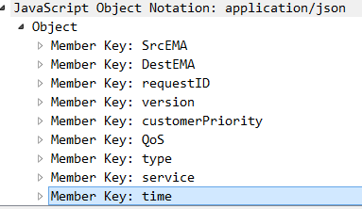
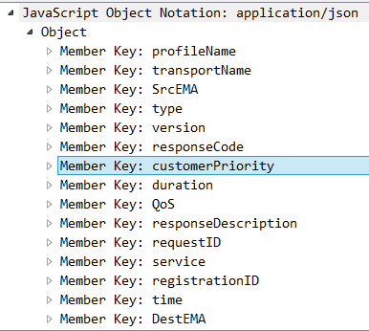
2. Smart Home Energy Framework : 2.2 EMAP(CoAP/JSON, MQTT/JSON) : Session Setup
파란색 : 기존 OpenADR Tag 부분
빨간색 : OpenADR확장된 Profile
초록색 : 삭제 또는 변경
Server EMA
192.168.1.127
(1) ConnectRegistration
Client EMA
192.168.1.101
(2) ConnectedPartyRegistration
(1) ConnectRegistration
(2) ConnectedPartyRegistration
ConnectRegistration Object{
“SrcEMA” : String,
“DestEMA” : String,
“requestID": String,
“service”: String,
“version” : String,
“time” : Date,
“type”: String => RegisteredReport 로 변경
“QoS” : String => RegisterReport로 변경
}
ConnectedRegistration Object{
“SrcEMA” : String,
“DestEMA” : String,
“responseCode” : Integer,
“responseDescription”: String,
“requestID": String,
“duration” : Integer,
“profile”: Array,
“profileName”: String,
“TransportName”: String,
“service”: String,
“version” : String,
“time” : Date,
“type”: String => RegisteredReport 로 변경
“QoS” : String => RegisterReport 로 변경,
“registrationID” : String
}
oadrProfile Array{
“oadrTransports”: Array,
“oadrProfileName”: String
}
oadrTransports Array{
“oadrTransportName”: String,
}

Slide 94
2.2 EMAP(MQTT, CoAP/JSON) Service : Session Setup
파란색 : 기존 OpenADR Tag 부분
빨간색 : OpenADR확장된 Profile
(3) CreatePartyRegistration
Server EMA
(4) CreatedPartyRegistration
Client EMA
(3) CreatePartyRegistration
(4) CreatedPartyRegistration
Key Name | Reference
 | OpenADR 2.0b | SEP 2.0(IEC 61968)
SrcEMA | ei:venID
DestEMA | ei:vtnID
requestID | pyld:requsetID
profileName | oadr:oadrProfileName
transportName | oadr:oadrTranportName
reportOnly | oadr:oadrReportOnly
xmlSignature | oadr:oadrXMLSignature
httpPullModel | oadr:oadrHttpPullModel
service | (Tag 이름으로 존재)
time |  | RandomizableEvent:creationTime
Key Name |  | Reference
 |  | OpenADR 2.0b |  | SEP 2.0(IEC 61968)
SrcEMA |  | ei:vtnID
DestEMA |  | ei:venID
responseCode |  | ei:eiResponse | Ei:responseCode
responseDescription |  |  | ei:responseDescription
requestID |  |  | Pyld:requestID
registrationID |  | ei:registrationID
profile | transports | Oadr:oadrProfile | oadrTransport: Array
 | profileName | Oadr:oadrProfile | oadrProfileName : String
profile: profileName: transports | transportName | Oadr:oadrProfile:oadrTransportname | oadrTransportName: String
duration |  | RandomizableEvent:randomizeDuration
service |  | (Tag 이름으로 존재)
time |  |  |  | RandomizableEvent:creation Time
Notes:
빨간색은 추가된 EMAP프로파일
파란색은 기존에서 변경된 값
초록색은 뺄 필요가 있어보이는 값

Slide 95
2.2 EMAP(MQTT, CoAP/JSON) Service : Session Setup
(3) CreatePartyRegistration
Server EMA
(4) CreatedPartyRegistration
Client EMA
(3) CreatePartyRegistration
(4) CreatedPartyRegistration
Key name | Comments
SrcEMA | source EMA identifier
DestEMA | destination EMA identifier
requestID | request identifier
profileName | profile name used by client EMA
transportName | transport name used by client EMA
reportOnly | EMA type (report only or full functional)
xmlSignature | xml 사용여부 true/false
httpPullMode | communication mode used by EMA (pull or push)
service | message type
time | service creation time
Key name |  |  | Comments
SrcEMA |  |  | source EMA identifier
DestEMA |  |  | destination EMA identifier
responseCode |  |  | response code
responseDescription |  |  | description of response code
requestID |  |  | request identifier
duration |  |  | requested polling frequency
registrationID |  |  | registration identifier
profile | profileName |  | type of profile
 | transports | transportName | type of transport protocol
version |  |  | EMAP protocol version
service |  |  | type of service
time |  |  | service creation time
Notes:
빨간색은 추가된 EMAP프로파일
파란색은 기존에서 변경된 값
초록색은 뺄 필요가 있어보이는 값

Slide 96
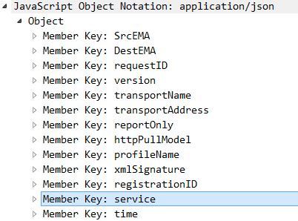
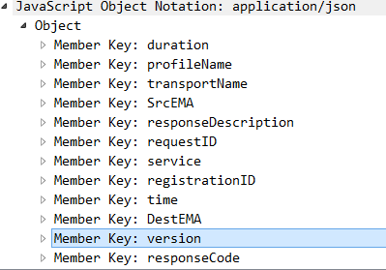
2. Smart Home Energy Framework : 2.2 EMAP(CoAP/JSON, MQTT/JSON) : Session Setup
파란색 : 기존 OpenADR Tag 부분
빨간색 : OpenADR확장된 Profile
초록색 : 삭제 또는 변경
Server EMA
192.168.1.127
(3) CreatePartyRegistration
Client EMA
192.168.1.101
(4) CreatedPartyRegistration
(3) CreatePartyRegistration
(4) CreatedPartyRegistration
CreatePartyRegistration Object{
“SrcEMA” : String,
“DestEMA” : String,
“version” : Integer => 삭제,
“requestID” : String,
“transportName” : String,
“reportOnly” : Integer,
“httpPullModel” : Boolean,
“profileName” : String,
“xmlSignature” : String,
“registrationID” : String 삭제,
“service”: String,
“time” : Date
}
CreatedPartyRegistration Object{
“SrcEMA” : String,
“DestEMA” : String,
“version": Integer => 삭제,
“requestID” : String,
“oadrProfile”: Array,
“registrationID”: String,
“duration” : String,
“responseCode” : Integer,
“responseDescription”: String,
“service”: String
“time” : Date,
}
oadrProfile Array{
“oadrTransports”: Array,
“oadrProfileName”: String
}
oadrTransports Array{
“oadrTransportName”: String,
}

Slide 97
2.2 EMAP(MQTT, CoAP/JSON) Service : Session Setup
파란색 : 기존 OpenADR Tag 부분
빨간색 : OpenADR확장된 Profile
Server EMA
(5) RegisterReport
(6) RegisterdReport
Client EMA
(5) RegisterReport
Key Name |  | Reference
 |  | OpenADR 2.0b |  | SEP 2.0(IEC 61968) | OpenFMB(IEC 61850)
SrcEMA |  | ei:venID
DestEMA |  | ei:vtnID
service |  | (tag이름으로 존재)
time |  |  |  | RandomizableEvent:creation Time
requestID |  | requestID
type(Implicit, Explicit) |  |  |  | TariffProfile:serviceCategoryKind:ServiceKind
report | duration | oadrReport | duration
 | reportDescription |  | oadrReportDescription
 | reportRequestID |  | reportRequestID
 | reportSpecifierID |  | reportSpecifierID
 | reportName |  | reportName
 | createdDateTime |  | createdDateTime
report:reportDescription | rID | oadrReport:oadrReportDescription | rID
 | resourceID |  | resourceID
 | deviceType |  |  |  | EndDeviceControlType:type
 | reportType |  | reportType
 | itemUnits |  | itemUnits
 | siScaleCode |  | siScaleCode
 | marketContext |  | marketContext
 | MinPeriod |  | oadrMinPeriod
 | MaxPeriod |  | oadrMaxPeriod
 | OnChange |  | oadrOnChange
 | itemDescription |  | itemDescription
 | powerAttributes |  | powerAttributes
 | qos |  |  | EndDeviceControl:loadShiftForward
 | state |  |  | DeviceStatus:opState
 | power |  |  |  | Readings: value
 | dimming |  |  | Subscription:Level
 | margin |  |  | IdentifiedObject:DemandResponseProgram:availabilityUpdatePowerChnageThreshold
 | generate |  |  |  | SolarEventProfile:SolarInveterrStatus:value
 | storage |  |  |  | BatteryEventProfile:BatteryStatus:value
 | maxValue |  |  |  | solarModule:SolarCapability:MaxVal
 | minValue |  |  |  | solarModule:SolarCapability:MinVal
 | avgValue |  |  |  | ResourceReading_MMTR:AvWh
 | maxTime |  |  | DeviceStatus:changedTime
 | minTime |  |  | DeviceStatus:changedTime
 | priority |  |  | Events:TextMessage:Priority
report:reportDescription:powerAttributes | hertz | oadrReport:oadrReportDescription:powerAttributes | Hertz
 | voltage |  | voltage
 | ac |  | ac
Notes:
빨간색은 추가된 EMAP프로파일
파란색은 기존에서 변경된 값
초록색은 뺄 필요가 있어보이는 값

Slide 98
2.2 EMAP(MQTT, CoAP/JSON) Service : Session Setup
파란색 : 기존 OpenADR Tag 부분
빨간색 : OpenADR확장된 Profile
(5) RegisterReport
Server EMA
(6) RegisteredReport
Client EMA
(6) RegisteredReport
Key Name | Reference
 | OpenADR 2.0b |  | SEP 2.0(IEC 61968)
SrcEMA |  | ei:venID
DestEMA |  | ei:vtnID
responseCode | ei:eiResponse | ei:responseCode
responseDescription |  | ei:responseDescription
requestID |  | pyld:requestID
service | (tag이름으로 존재)
time |  |  | RandomizableEvent:creation Time
Notes:
빨간색은 추가된 EMAP프로파일
파란색은 기존에서 변경된 값
초록색은 뺄 필요가 있어보이는 값

Slide 99
2.2 EMAP(MQTT, CoAP/JSON) Service : Session Setup
Server EMA
(5) RegisterReport
(6) RegisterdReport
Client EMA
(5) RegisterReport
Key name |  |  |  | Comments
SrcEMA |  |  |  | source EMA identifier
DestEMA |  |  |  | destination EMA identifier
requestID |  |  |  | request identifier
report | duration |  |  | report duration
 | reportRequestID |  |  | report request identifier
 | reportSpecifierID |  |  | report specific id (created from EMA)
 | reportName |  |  | report name
 | createdDateTime |  |  | created time of this report
 | reportDescription | rID
 |  | resourceID |  | resource identifier
 |  | reportType |  | report type
 |  | deviceType |  | type of device
 |  | itemUnits |  | unit of item that report
 |  | siScaleCode
 |  | marketContext |  | refer marketContext address
 |  | minPeriod |  | Energy usage minimum period
 |  | maxPeriod |  | Energy usage maximum period
 |  | onChange
 |  | itemDescription |  | type of item that report
 |  | qos |  | device QoS
 |  | state |  | device current state
 |  | power |  | power usage
 |  | dimming |  | dimming state
 |  | margin |  | available amount of energy (Including generated, storaged Energy)
 |  | generate |  | generated energy
 |  | storage |  | soraged energy
 |  | maxValue |  | energy max usage value
 |  | minValue |  | energy min usage vaalue
 |  | avgValue |  | energy average usage value
 |  | maxTime |  | energy max usage time
 |  | minTime |  | energy min usage time
 |  | priority |  | priority of this device
 |  | powerAttributes | hertz | pulse frequency of power
 |  |  | voltage | voltage of power
 |  |  | ac | Is this AC power? (True or False)
service |  |  |  | type of service
time |  |  |  | service creation time
type |  |  |  | report message type (implicit or explicit)
Notes:
빨간색은 추가된 EMAP프로파일
파란색은 기존에서 변경된 값
초록색은 뺄 필요가 있어보이는 값

Slide 100
2.2 EMAP(MQTT, CoAP/JSON) Service : Session Setup
(5) RegisterReport
Server EMA
(6) RegisteredReport
Client EMA
(6) RegisteredReport
Key name | Comments
SrcEMA | source EMA identifier
DestEMA | destination EMA identifier
requestID | request identifier
responseCode | response code
responseDescription | description of response code
service | message type
time | service creation time
Notes:
빨간색은 추가된 EMAP프로파일
파란색은 기존에서 변경된 값
초록색은 뺄 필요가 있어보이는 값

Slide 101
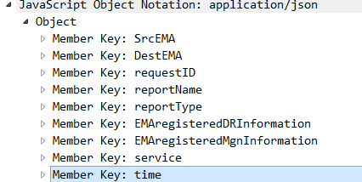
2. Smart Home Energy Framework : 2.2 EMAP(CoAP/JSON, MQTT/JSON) : Session Setup
파란색 : 기존 OpenADR Tag 부분
빨간색 : OpenADR확장된 Profile
초록색 : 삭제 또는 변경
Server EMA
192.168.1.127
(5) RegisterReport
Client EMA
192.168.1.101
(6) RegisteredReport
(5) RegisterReport
(6) RegisteredReport
RegisterReport Object{
“SrcEMA” : String,
“DestEMA” : String,
“requestID": String,
“reportType” : String,
“EMAregisteredDRinformation” : Object =>변경
“EMAregisteredMgnInformation” : Object => 변경, “report” : Array,
“time”: Date,
“service” : String,
“type”: String (Explicit, Implict인지 구분)
}
report Object{
“duration” : String,
“reportRequestID” : Integer,
“reportSpecifierID” : String,
“reportName” : String,
“createdDateTime” : Date,
“reportDescription” : Array,
}
reportDescription Object{
“rID” : String,
“resourceID” : String,
“deviceType” : String,
“reportType” : String,
“itemUnits” : String,
“siScaleCode” : String,
“marketContext” : String,
“oadrMinPeriod” : String,
“oadrMaxPeriod” : String,
“oadrOnChange” : String,
“itemDescription” : String,
“powerAttributes” : Array,
“qos” : String
“state” : String,
“power” : Double,
“dimming” : Integer,
“margin” : double,
“generate” : double,
“storage” : String,
“maxValue” : Double,
“minValue” : Double,
“avgValue” : Double,
“maxTime” : Date,
“minTime” : Date,
“priority” : Integer
}
powerAttributes Object{
“hertz” : Double,
“voltage” : Double,
“ac” : Boolean
}

Slide 102
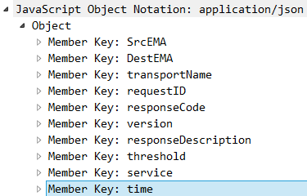
2. Smart Home Energy Framework : 2.2 EMAP(CoAP/JSON, MQTT/JSON) : Session Setup
파란색 : 기존 OpenADR Tag 부분
빨간색 : OpenADR확장된 Profile
초록색 : 삭제 또는 변경
Server EMA
192.168.1.127
(5) RegisterReport
Client EMA
192.168.1.101
(6) RegisteredReport
(5) RegisterReport
(6) RegisteredReport
RegisteredReport Object{
“SrcEMA” : String,
“DestEMA” : String,
“requestID": String,
“responseCode” : Integer,
“responseDescription”: String,
“transportName: String=>기존 OpenADR에 없는 내용,
“version": Integer=>삭제,
“threshold” : Double =>DistributeEvent로 이동,
“service”: String,
“time” : Date,
}

Slide 103
2.2 EMAP(MQTT, CoAP/JSON) Service : Session Setup
파란색 : 기존 OpenADR Tag 부분
빨간색 : OpenADR확장된 Profile
(7) Poll
Server EMA
(8) RegisterReport
Client EMA
(7) Poll
(8) RegisterReport
Key Name | Reference
 | OpenADR 2.0b | SEP 2.0(IEC 61968)
SrcEMA | ei:venID
DestEMA | ei:vtnID
service | (tag이름으로 존재)
time |  | RandomizableEvent:creation Time
Key Name | Reference
 | OpenADR 2.0b |  | SEP 2.0(IEC 61968)
SrcEMA | ei:vtnID
DestEMA | ei:venID
requestID | ei:eiResponse | Pyld:requestID
service | (tag이름으로 존재)
time |  |  | RandomizableEvent:creationTime
Notes:
빨간색은 추가된 EMAP프로파일
파란색은 기존에서 변경된 값
초록색은 뺄 필요가 있어보이는 값

Slide 104
2.2 EMAP(MQTT, CoAP/JSON) Service : Session Setup
(7) Poll
Server EMA
(8) RegisterReport
Client EMA
(7) Poll
(8) RegisterReport
Key name | Comments
SrcEMA | source EMA identifier
DestEMA | destination EMA identifier
service | message type
time | service creation time
Key name | Comments
SrcEMA | source EMA identifier
DestEMA | destination EMA identifier
requestID | request identifier
service | type of service
time | service creation time
Notes:
빨간색은 추가된 EMAP프로파일
파란색은 기존에서 변경된 값
초록색은 뺄 필요가 있어보이는 값

Slide 105
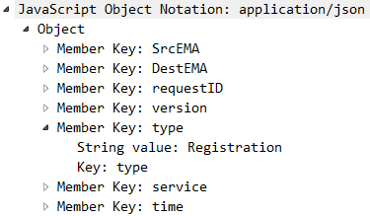
2. Smart Home Energy Framework : 2.2 EMAP(CoAP/JSON, MQTT/JSON) : Session Setup
파란색 : 기존 OpenADR Tag 부분
빨간색 : OpenADR확장된 Profile
초록색 : 삭제 또는 변경
Server EMA
192.168.1.127
(7) Poll
Client EMA
192.168.1.101
(8) RegisterReport
(7) Poll
(8) RegisterReport
Poll JSON Object{
“SrcEMA” : String,
“DestEMA” : String,
“requestID": Integer, =>삭제
“version": Integer=>삭제,
“type” : String => 삭제(RegisteredReport로 변경)
“service” : String,
“time” : Date
}

Slide 106
2. Smart Home Energy Framework : 2.2 EMAP(CoAP/JSON, MQTT/JSON) : Session Setup
파란색 : 기존 OpenADR Tag 부분
빨간색 : OpenADR확장된 Profile
초록색 : 삭제 또는 변경
Server EMA
192.168.1.127
(7) Poll
Client EMA
192.168.1.101
(8) RegisterReport
(7) Poll
(8) RegisterReport
RegisterReport Object{
“SrcEMA” : String,
“DestEMA” : String,
“requestID": String,
“time”: Date,
“service” : String
}

Slide 107
2.2 EMAP(MQTT, CoAP/JSON) Service : Session Setup
파란색 : 기존 OpenADR Tag 부분
빨간색 : OpenADR확장된 Profile
Server EMA
(9) RegisteredReport
Client EMA
(10) Response
(9) RegisteredReport
(10) Response
Key Name | Reference
 | OpenADR 2.0b |  | SEP 2.0(IEC 61968)
SrcEMA | ei:vtnID
DestEMA | ei:venID
responseCode | ei:eiResponse | ei:responseCode
responseDescription |  | ei:responseDescription
requestID |  | Pyld:requestID
service | (tag이름으로 존재)
time |  |  | RandomizableEvent:creationTime
Key Name | Reference
 | OpenADR 2.0b |  | SEP 2.0(IEC 61968)
SrcEMA | ei:vtnID
DestEMA | ei:venID
responseCode | ei:eiResponse | ei:responseCode
responseDescription |  | ei:responseDescription
requestID |  | Pyld:requestID
service | (tag이름으로 존재)
time |  |  | RandomizableEvent:creationTime
Notes:
DESTEMA => CEMAID로 변경

Slide 108
2.2 EMAP(MQTT, CoAP/JSON) Service : Session Setup
Server EMA
(9) RegisteredReport
Client EMA
(10) Response
(9) RegisteredReport
(10) Response
Key name | Comments
SrcEMA | source EMA identifier
DestEMA | destination EMA identifier
requestID | request identifier
responseCode | response code
responseDescription | description of response code
service | message type
time | service creation time
Key name | Comments
SrcEMA | source EMA identifier
DestEMA | destination EMA identifier
requestID | request identifier
responseCode | response code
responseDescription | description of response code
service | type of service
time | service creation time
Notes:
DESTEMA => CEMAID로 변경

Slide 109
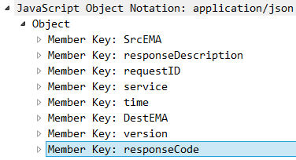
2. Smart Home Energy Framework : 2.2 EMAP(CoAP/JSON, MQTT/JSON) : Session Setup
파란색 : 기존 OpenADR Tag 부분
빨간색 : OpenADR확장된 Profile
초록색 : 삭제 또는 변경
Server EMA
192.168.1.127
(9) RegisteredReport
Client EMA
192.168.1.101
(10) Response
(9) RegisteredReport
(10) Response
RegisteredReport Object{
“SrcEMA” : String,
“DestEMA” : String,
“requestID": String,
“responseCode” : Integer,
“responseDescription”: String,
“transportName: String=>기존 OpenADR에 없는 내용,
“version": Integer=>삭제,
“threshold” : Double =>DistributeEvent로 이동,
“service”: String,
“type” : String,
“time” : Date,
}
Response Object{
“SrcEMA” : String,
“DestEMA” : String,
“requestID": String,
“responseCode” : Integer,
“responseDescription”: String,
“version": Integer=>삭제,
“service”: String,
“time” : Date
}

Slide 110
2.2 EMAP(MQTT, CoAP/JSON) Service : Session Setup
파란색 : 기존 OpenADR Tag 부분
빨간색 : OpenADR확장된 Profile
(11) RequestEvent
Server EMA
(12) DistributeEvent
Client EMA
(11) RequestEvent
Key Name |  | Reference
 |  | OpenADR 2.0b | SEP 2.0(IEC 61968)
SrcEMA | ei:venID
DestEMA | ei:vtnID
requestID | pyld:eiRequestEvent | pyld:requestID
service | (tag이름으로 존재)
time |  |  | RandomizableEvent:creation Time

Slide 111
2.2 EMAP(MQTT, CoAP/JSON) Service : Session Setup
파란색 : 기존 OpenADR Tag 부분
빨간색 : OpenADR확장된 Profile
(11) RequestEvent
Server EMA
(12) DistributeEvent
Client EMA
(12) DistributeEvent
Key Name |  | Reference
 |  | OpenADR 2.0b |  | SEP 2.0(IEC 61968)
SrcEMA |  | ei:vtnID
DestEMA |  | ei:venID
requestID |  | ei:requestID
responseRequired |  | Ei:reponseRequired
response | requestID | ei:Response | pyld:requestID
 | responseCode |  | ei:responseCode
 | responseDescription |  | ei:responseDescription
event | eventID | oadrEvent:eiActivePeriod:eventDescriptor | eventID
 | eventSignals |  | eventSignals
 | modificationNumber |  | modificationNumber
 | modificationReason |  | modificationReason
 | priority |  | priority
 | marketContext |  | eiMarketContext
 | createdDateTime |  | createdDateTime
 | eventStatus |  | eventStatus
 | testEvent |  | testEvent
 | vtnComment |  | vtnComment
 | properties | oadrEvent:eiActivePeriod | properties
 | components |  | components
 | specificDestEMA | oadrEvent:eiTarget | venID
 | dtStart | oadrEvent:eiActivePeriod:properties | dtstart
 | Duration |  | duration
 | Tolerance |  | tolerance
 | notification |  | x-eiNotification
 | rampUp |  | x-eiRampUp
 | Recovery |  | x-eiRecovery
event:eventSignals | eventSignal | oadrEvent:eiEventSignals | eiEventSignal
 | Intervals | oadrEvent:eiEventSignals:eiEventSignal | intervals
 | signalName |  | signalName
 | signalType (Price Event, Control Event, Reserve Mode, RealtimeDR) |  | signalType
 | signalID |  | signalID
 | currentValue |  | currentValue
 | threshold |  |  | IdentifiedObject:DemandResponseProgram:availabilityUpdatePowerChnageThreshold
 | capacity |  |  | AccountBalance:availableCredit
 | price |  |  | PriceResponseCgfObject
 | unit |  |  | CurrencyCodeObject
event:eventSignals:eventSignal:intervals | duration | oadrEvent:eiEventSignals:eiEventSignal:intervals:interval | duration
 | uid |  | uid
 | value |  | signalPayload
service |  | (Tag 이름으로 존재)
time |  |  |  | RandomizableEvent:creation Time
signalType으로 Price Event인지
Control Event, Reserve Mode, RealtimeDR인지 구분한다

Slide 112
2.2 EMAP(MQTT, CoAP/JSON) Service : Session Setup
(11) RequestEvent
Server EMA
(12) DistributeEvent
Client EMA
(11) RequestEvent
Key name | Comments
SrcEMA | source EMA identifier
DestEMA | destination EMA identifier
requestID | request identifier
service | type of service
time | service creation time

Slide 113
2.2 EMAP(MQTT, CoAP/JSON) Service : Session Setup
(11) RequestEvent
Server EMA
(12) DistributeEvent
Client EMA
(12) DistributeEvent
Key name |  |  |  | Comments
SrcEMA |  |  |  | source EMA identifier
DestEMA |  |  |  | destination EMA identifier
response | requestID |  |  | request identifier
 | responseCode |  |  | response code
 | responseDescription |  |  | description of response code
event | eventID |  |  | event identifier
 | eventSiganls | intervals | duration | event signal interval duration
 |  |  | uid | event user id
 |  |  | value | event value
 |  | signalName |  | event signal name
 |  | signalType |  | event signal type (bi direct, level)
 |  | signalID |  | event signal ID
 |  | currentValue |  | current usage value
 |  | threshold |  | available amount of energy
 |  | capacity |  | 사용 가능량 (threshold - power)
 |  | price |  | price of energy
 |  | unit |  | 단위
 | modificationNumber |  |  | modification Number(count)
 | modificationReason |  |  | modification reason(event reason)
 | priority |  |  | priority
 | marketContext |  |  | market address(market reference)
 | createdDateTime |  |  | event create date & time
 | eventStatus |  |  | event status
 | testEvent |  |  | if event test or not
 | vtnComment
 | dtStart |  |  | event start time
 | duration |  |  | event duration
 | properties
 | components
 | specificDestEMA |  |  | specific target EMA
 | tolerance |  |  | tolerance duration
 | notification |  |  | notification duration
 | rampUp |  |  | ramp up duration
 | recovery
responseRequired |  |  |  | response mandatory or not
service |  |  |  | type of service
time |  |  |  | service creation time

Slide 114
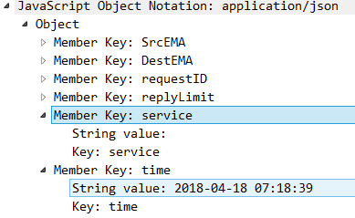
2. Smart Home Energy Framework : 2.2 EMAP(CoAP/JSON, MQTT/JSON) : Session Setup
파란색 : 기존 OpenADR Tag 부분
빨간색 : OpenADR확장된 Profile
초록색 : 삭제 또는 변경
Server EMA
192.168.1.127
(11) RequestEvent
Client EMA
192.168.1.101
(12) DistributeEvent
(11) RequestEvent
(12) DistributeEvent
RequestEvent Object{
“SrcEMA” : String,
“DestEMA” : String,
“requestID": String,
“replyLimit” : Integer => 삭제,
“time” : Date,
“service”: String
}

Slide 115
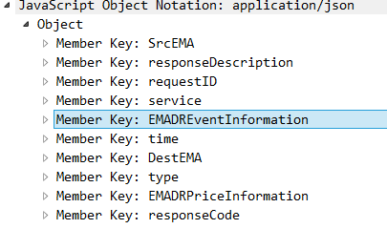
2. Smart Home Energy Framework : 2.2 EMAP(CoAP/JSON, MQTT/JSON) : Session Setup
파란색 : 기존 OpenADR Tag 부분
빨간색 : OpenADR확장된 Profile
초록색 : 삭제 또는 변경
Server EMA
192.168.1.127
(11) RequestEvent
Client EMA
192.168.1.101
(12) DistributeEvent
(11) RequestEvent
(12) DistributeEvent
DistributeEvent Object{
“SrcEMA” : String,
“DestEMA” : String,
“requestID” : String,
“response” : Array,
“event” : Array,
“responseRequired” : String,
“service” : String,
“time” : Date
}
event Array{
“eventID” : String,
“eventSignals” : Array,
“modificationNumber” : Integer,
“modificationReason” : String,
“priority” : Integer,
“marketContext” : String,
“createdDataTime” : Date,
“eventStatus” : String,
“testEvent” : Boolean,
“vtnComment” : String,
“dtstart” : Date,
“duration” : String,
“properties” : String,
“components” : String,
“specificDestEMA” : String,
“tolerance” : String,
“notification” : String,
“rampUp” : String,
“recovery” : String
}
eventSignals Object{
“eventSignal” : String,
“intervals” : Array,
“signalName” : String,
“signalType” : String, (Price Event, Control Event, Reserve
Mode, RealtimeDR인지 구분)
“signalID” : String,
“currentValue” : Double,
“threshold” : Double,
“capacity” : Double,
“price” : Integer,
“unit” : String,
}
response Array{
“requestID” : String,
“responseCode” : Integer,
“responseDescription” : String
}
intervals Array{
“duration” : String,
“uid” : Integer,
“value” : Double
}

Slide 116
2.2 EMAP(MQTT, CoAP/JSON) Service : Session Setup
파란색 : 기존 OpenADR Tag 부분
빨간색 : OpenADR확장된 Profile
(13) CancelPartyRegistration
Server EMA
(14) CanceledPartyRegistration
Client EMA
(13) CancelPartyRegistration
(14) CanceledPartyRegistration
Key Name | Reference
 | OpenADR 2.0b | SEP 2.0(IEC 61968)
SrcEMA | ei: venID
DestEMA | ei: vtnID
requestID | pyld:requestID
regiatistronID | regiatistronID
service | (Tag 이름으로 존재)
time |  | RandomizableEvent:creation Time
Key Name | Reference
 | OpenADR 2.0b |  | SEP 2.0(IEC 61968)
SrcEMA | ei:vtnID
DestEMA | ei:venID
responseCode | ei:eiResponse | ei:responseCode
responseDescription |  | ei:responseDescription
requestID |  | Pyld:requestID
service | (Tag 이름으로 존재)
regiatistronID
time |  |  | RandomizableEvent:creationTime
Notes:
빨간색은 추가된 EMAP프로파일 : version, service, time은 그대로
파란색은 기존에서 변경된 값
초록색은 뺄 필요가 있어보이는 값 (QoS, Type: ?)

Slide 117
2.2 EMAP(MQTT, CoAP/JSON) Service : Session Setup
(13) CancelPartyRegistration
Server EMA
(14) CanceledPartyRegistration
Client EMA
(13) CancelPartyRegistration
(14) CanceledPartyRegistration
Key name | Comments
SrcEMA | source EMA identifier
DestEMA | destination EMA identifier
requestID | request identifier
registrationID | registration identifier
service | type of service
time | service creation time
Key name | Comments
SrcEMA | source EMA identifier
DestEMA | destination EMA identifier
requestID | request identifier
responseCode | response code
responseDescription | description of response code
registrationID | registration identifier
service | type of service
time | service creation time
Notes:
빨간색은 추가된 EMAP프로파일 : version, service, time은 그대로
파란색은 기존에서 변경된 값
초록색은 뺄 필요가 있어보이는 값 (QoS, Type: ?)

Slide 118
2. Smart Home Energy Framework : 2.2 EMAP(CoAP/JSON, MQTT/JSON) : Session Setup
파란색 : 기존 OpenADR Tag 부분
빨간색 : OpenADR확장된 Profile
초록색 : 삭제 또는 변경
Server EMA
192.168.1.127
(13) CancelPartyRegistration
Client EMA
192.168.1.101
(14) CanceledPartyRegistration
(13) CancelPartyRegistration
(14) CanceledPartyRegistration
CancelPartyRegistration Object{
“SrcEMA” : String,
“DestEMA” : String,
“requestID” : String,
“registrationID” : String
“service” : String,
“time” : Date
}
CanceledPartyRegistration Object{
“SrcEMA” : String,
“DestEMA” : String,
“requestID” : String,
“responseCode” : Integer,
“responseDescription” : String,
“registrationID” : String
“service” : String,
“time” : Date
}

Slide 119
EMAP (CoAP & MQTT/JSON)
UpdateReport

Slide 120
2.2 EMAP(MQTT, CoAP/JSON) Service : Update Report
EMAP
- EMA사이의 수요반응 통신 프로토콜이며 OpenADR 2.0b의 모델링을 따랐으며
일부 모델링을 확장했고 Discovery와 Monitoring, Control 부분의 통신 프로토콜이 확장.
Server EMA
(Client EMA)
EMAP
Client EMA
Session Setup(Registration)
Discovery
Report(updateReport)
에너지관리에이전트 간 서로 연결을 수립 할 때 Report을 교환할 때 실시간 에너지에 대한 가격 정보나 클라이언트 에너지관리에이전트의 디바이스 정보 등을 얻음.
하위의 EMA의 정보를 모니터링 하는 단계, Explicit/Abstract 방식으로 Monitoring.
Explicit에는 Device Type (LED, ESS, Recloser, Resource, PV)에 대한 정보가 포함
Implicit에는 Device Type을 제외한 정보가 포함되어 있어 필요로 하는 정보에 따라 데이터 트래픽을 다르게 설정할 수 있음.
Report
Monitoring
Demand Response Event
Control
Opt
Notes:
- SEP2.0 은 집안에서 운용되며, OpenADR 은 바운더리가 굉장히 넓다.
- SEP2.0 은 미터링등에 대한 정보를 OpenADR 을 통해서 ISO 나 에너지공급자에게 전달하며
- OpenADR 은 그것에 따른 과금,수요반응을 집안에 있는 디비이스에 SEP2.0을 통하여 전달한다. (양방향 통신)
그 데이터들은 인하우스디스플레이나 스마트폰을 통해서 사용자에게 전달된다.
- SEP2.0 은 집안의 HAN 상에서 디바이스들 끼리 커뮤케이션되게 해야한다.
- SEP2.0 은 커뮤티케이션 언어로 Restful Web 과 EXI 사용하며 , OpenADR 은 xml 기반이다.
따라서 SEP2.0 <--> OpenADR 간에 통신하기위해서는 언어매핑을 해줘야한다.
- SEP2.0 은 IP 기반이므로 Ethernet,WIFI 등을 지원한다. 그것에 맞추어 Zigbee IP 가 만들어졌고 Z/IP Z-wave 가 있다.
- SEP2.0 의 IP 기반의 HAN 상에서 mDNS 를 사용하여 서로를 감지한다.
- SEP2.0 을 준수하는 디바이스끼리는 SEP2.0 의 정해진 스펙(기능셋) 에 따라서 대화한다.
- SEP2.0 과 OpenADR 2 사이에 커뮤니케이션을 원할하게 하기위한 노력이 이루어지고있다.

Slide 121
2.2 EMAP(MQTT, CoAP/JSON) Service : Update Report
VTN
OpenADR
HTTP/XML
VEN
Server EMA
EMAI Protocol
Client EMA
(Server EMA)
Device Protocol
Smart Appliance
EMA
UpdateReport
UpdateReport
Extended
OpenADR
UpdateReport
Original
OpenADR 2.0b
…
UpdateReport
+ qos : String,
+ state : String,
+ power : Double,
+ dimming : Integer,
+ margin : Double,
+ generate : Double,
+ storage : String,
+ maxValue : Double,
+ minValue : Double,
+ maxTime : Date,
+ minTime : Date,
+ priority : Integer,
+ time : Date

Slide 122
2.2 EMAP(MQTT, CoAP/JSON) Service : Update Report
VTN
OpenADR
HTTP/XML
MQTT/JSON
CoAP/JSON
VEN
Server EMA
EMAI Protocol
Client EMA
(Server EMA)
GCON Protocol
Device
EiRegisterParty(QueryRegistration)
ConnectRegistration
HTTP 200 OK(CreatedPartyRegistration)
ConnectedPartyRegistration
CreatePartyRegistration
EiRegisterParty(CreatePartyRegistration)
CreatedPartyRegistration
HTTP 200 OK(CreatedPartyRegistration)
RegisterReport
EiReport(RegisterReport)
RegisteredReport
HTTP 200 OK(RegisteredReport)
RegisterReport
Poll
RegisterReport
RegisteredReport
OadrPoll
RegisteredReport
HTTP 200 OK(RegisterReport)
Response
Poll
EiReport(RegisteredReport)
RequestEvent
RegisterReport
DistributeEvent
HTTP 200 OK(oadrResponse)
RegisteredReport
EiEvent(RequestEvent)
UpdateReport
Response
UpdatedReport
HTTP 200 OK(oadrResponse)
RequestEvent
DistributeEvents

Slide 123
EMAP
(2) UpdateReport
CoAP / JSON
MQTT / JSON

Slide 124
2.2 EMAP(CoAP/JSON) Service : Update Report
Client EMA
Server EMA
PUT : /EMAP/SEMA/1.0b/UpdateReport
Payload : UpdateReport
Response : 2.05 Content
Payload : UpdatedReport

Slide 125
2. Smart Home Energy Framework : 2.2 EMAP(MQTT/JSON, CoAP/JSON) : UpdateReport
파란색 : 기존 OpenADR Tag 부분
빨간색 : OpenADR확장된 Profile
(1) UpdateReport
Key Name |  | Reference
 |  | OpenADR 2.0b |  | SEP 2.0(IEC 61968) | OpenFMB(IEC 61850)
SrcEMA |  | ei:venID
DestEMA |  | ei:vtnID
service |  | (Tag 이름으로 존재)
time |  |  |  | RandomizableEvent:creation Time
requestID |  | requestID
type(Implicit, Explicit)
report | duration | oadrReport | duration
 | reportDescription |  | oadrReportDescription
 | reportRequestID |  | reportRequestID
 | reportSpecifierID |  | reportSpecifierID
 | reportName |  | reportName
 | createdDateTime |  | createdDateTime
report:reportDescription | rID | oadrReport:oadrReportDescription | rID
 | resourceID |  | resourceID
 | deviceType |  |  |  | EndDeviceControlType:type
 | reportType |  | reportType
 | itemUnits |  | itemUnits
 | siScaleCode |  | siScaleCode
 | marketContext |  | marketContext
 | MinPeriod |  | oadrMinPeriod
 | MaxPeriod |  | oadrMaxPeriod
 | OnChange |  | oadrOnChange
 | itemDescription |  | itemDescription
 | powerAttributes |  | powerAttributes
 | qos |  |  | EndDeviceControl:loadShiftForward
 | state |  |  | DeviceStatus:opState
 | power |  |  |  | Readings: value
 | dimming |  |  | Subscription:Level
 | margin |  |  | IdentifiedObject:DemandResponseProgram:availabilityUpdatePowerChnageThreshold
 | generate |  |  |  | SolarEventProfile:SolarInveterrStatus:value
 | storage |  |  |  | BatteryEventProfile:BatteryStatus:value
 | maxValue |  |  |  | solarModule:SolarCapability:MaxVal
 | minValue |  |  |  | solarModule:SolarCapability:MinVal
 | avgValue |  |  |  | ResourceReading_MMTR:AvWh
 | maxTime |  |  | DeviceStatus:changedTime
 | minTime |  |  | DeviceStatus:changedTime
 | priority |  |  | Events:TextMessage:Priority
report:reportDescription:powerAttributes | hertz | oadrReport:oadrReportDescription:powerAttributes | Hertz
 | voltage |  | Voltage
 | ac |  | ac

Slide 126
2. Smart Home Energy Framework : 2.2 EMAP(MQTT/JSON, CoAP/JSON) : UpdateReport
파란색 : 기존 OpenADR Tag 부분
빨간색 : OpenADR확장된 Profile
(2) UpdatedReport
Key Name | Reference
 | OpenADR 2.0b |  | SEP 2.0(IEC 61968) | OpenFMB(IEC 61850)
SrcEMA | ei:venID
DestEMA | ei:vtnID
requestID | ei:eiResponse | pyld:requestID
responseCode |  | ei:responseCode
responseDescription |  | ei:responseDescription
service | (Tag 이름으로 존재)
type |  |  | IdentifiedObject:TrafiiProfile:ServiceKind
time |  |  | RandomizableEvent:creation Time
type: Explicit, Implicit

Slide 127
2. Smart Home Energy Framework : 2.2 EMAP(MQTT/JSON, CoAP/JSON) : UpdateReport
(1) UpdateReport
Key name |  |  |  | Comments
SrcEMA |  |  |  | source EMA identifier
DestEMA |  |  |  | destination EMA identifier
requestID |  |  |  | request identifier
report | duration |  |  | report duration
 | reportRequestID |  |  | report request identifier
 | reportSpecifierID |  |  | report specific id (created from ven)
 | reportName |  |  | report name
 | createdDateTime |  |  | created time of this report
 | reportDescription | rID
 |  | resourceID |  | resource identifier
 |  | reportType |  | report type
 |  | deviceType |  | type of device
 |  | itemUnits |  | unit of item that report
 |  | siScaleCode
 |  | marketContext |  | refer marketContext address
 |  | minPeriod |  | Energy usage minimum period
 |  | maxPeriod |  | Energy usage maximum period
 |  | onChange
 |  | itemDescription |  | type of item that report
 |  | qos |  | device QoS
 |  | state |  | device current state
 |  | power |  | power usage
 |  | dimming |  | dimming state
 |  | margin |  | available amount of energy (Including generated, storaged Energy)
 |  | generate |  | generated energy
 |  | storage |  | soraged energy
 |  | maxValue |  | energy max usage value
 |  | minValue |  | energy min usage vaalue
 |  | avgValue |  | energy average usage value
 |  | maxTime |  | energy max usage time
 |  | minTime |  | energy min usage time
 |  | priority |  | priority of this device
 |  | powerAttributes | hertz | pulse frequency of power
 |  |  | voltage | voltage of power
 |  |  | ac | Is this AC power? (True or False)
service |  |  |  | type of service
time |  |  |  | service creation time
type |  |  |  | report message type (implicit or explicit)

Slide 128
2. Smart Home Energy Framework : 2.2 EMAP(MQTT/JSON, CoAP/JSON) : UpdateReport
(2) UpdatedReport
Key name | Comments
SrcEMA | source EMA identifier
DestEMA | destination EMA identifier
requestID | request identifier
responseCode | response code
responseDescription | description of response code
service | type of service
time | service creation time

Slide 129
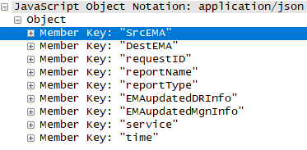
2. Smart Home Energy Framework : 2.2 EMAP(CoAP/JSON, MQTT/JSON) : UpdateReport (Implicit, Explicit)
파란색 : 기존 OpenADR Tag 부분
빨간색 : OpenADR확장된 Profile
초록색 : 삭제 또는 변경
Server EMA
192.168.1.127
(1) UpdateReport
Client EMA
192.168.1.101
(2) UpdatedReport
UpdateReport
UpdateReport Object{
“SrcEMA” : String,
“DestEMA” : String,
“requestID": String,
“reportType” : String,
“EMAregisteredDRinformation” : Object =>변경
“EMAregisteredMgnInformation” : Object => 변경, “report” : Array,
“time”: Date,
“service” : String,
“type”: String (Explicit, Implict인지 구분)
}
report Object{
“duration” : String,
“reportRequestID” : Integer,
“reportSpecifierID” : String,
“reportName” : String,
“createdDateTime” : Date,
“reportDescription” : Array,
}
reportDescription Object{
“rID” : String,
“resourceID” : String,
“deviceType” : String,
“reportType” : String,
“itemUnits” : String,
“siScaleCode” : String,
“marketContext” : String,
“oadrMinPeriod” : String,
“oadrMaxPeriod” : String,
“oadrOnChange” : String,
“itemDescription” : String,
“powerAttributes” : Array,
“qos” : String
“state” : String,
“power” : Double,
“dimming” : Integer,
“margin” : double,
“generate” : double,
“storage” : String,
“maxValue” : Double,
“minValue” : Double,
“avgValue” : Double,
“maxTime” : Date,
“minTime” : Date,
“priority” : Integer
}
powerAttributes Object{
“hertz” : Double,
“voltage” : Double,
“ac” : Boolean
}

Slide 130
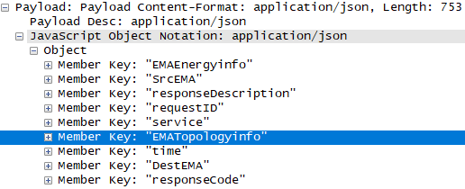
2. Smart Home Energy Framework : 2.2 EMAP(CoAP/JSON, MQTT/JSON) : UpdateReport (Implicit, Explicit)
파란색 : 기존 OpenADR Tag 부분
빨간색 : OpenADR확장된 Profile
초록색 : 삭제 또는 변경
Server EMA
192.168.1.127
(1) UpdateReport
Client EMA
192.168.1.101
(2) UpdatedReport
(2) UpdatedReport
UpdatedReport Object{
“SrcEMA” : String,
“DestEMA” : String,
“requestID”: String,
“responseCode”: Integer,
“responseDescription” : String,
“EMAEnergyinfo” : Object =>삭제
“service”: String,
“time”: Date
}

Slide 131
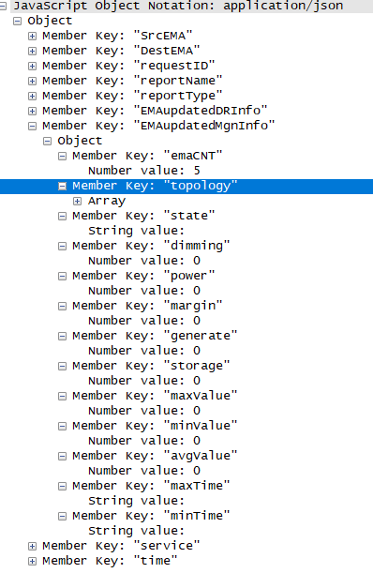
2. Smart Home Energy Framework : 2.2 EMAP(CoAP/JSON, MQTT/JSON) : UpdateReport (Implicit, Explicit)
파란색 : 기존 OpenADR Tag 부분
빨간색 : OpenADR확장된 Profile
초록색 : 삭제 또는 변경
Server EMA
192.168.1.127
(1) UpdateReport
Client EMA
192.168.1.101
(2) UpdatedReport
UpdateReport
UpdateReport Object{
“SrcEMA” : String,
“DestEMA” : String,
“requestID": String,
“reportType” : String,
“EMAregisteredDRinformation” : Object =>변경
“EMAregisteredMgnInformation” : Object => 변경, “report” : Array,
“time”: Date,
“service” : String,
“type”: String (Explicit, Implict인지 구분)
}
report Object{
“duration” : String,
“reportRequestID” : Integer,
“reportSpecifierID” : String,
“reportName” : String,
“createdDateTime” : Date,
“reportDescription” : Array,
}
reportDescription Object{
“rID” : String,
“resourceID” : String,
“deviceType” : String,
“reportType” : String,
“itemUnits” : String,
“siScaleCode” : String,
“marketContext” : String,
“oadrMinPeriod” : String,
“oadrMaxPeriod” : String,
“oadrOnChange” : String,
“itemDescription” : String,
“powerAttributes” : Array,
“qos” : String
“state” : String,
“power” : Double,
“dimming” : Integer,
“margin” : double,
“generate” : double,
“storage” : String,
“maxValue” : Double,
“minValue” : Double,
“avgValue” : Double,
“maxTime” : Date,
“minTime” : Date,
“priority” : Integer
}
powerAttributes Object{
“hertz” : Double,
“voltage” : Double,
“ac” : Boolean
}

Slide 132
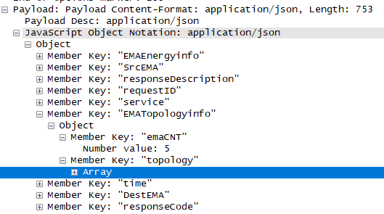
2. Smart Home Energy Framework : 2.2 EMAP(CoAP/JSON, MQTT/JSON) : UpdateReport (Implicit, Explicit)
파란색 : 기존 OpenADR Tag 부분
빨간색 : OpenADR확장된 Profile
초록색 : 삭제 또는 변경
Server EMA
192.168.1.127
(1) UpdateReport
Client EMA
192.168.1.101
(2) UpdatedReport
(2) UpdatedReport
UpdatedReport Object{
“SrcEMA” : String,
“DestEMA” : String,
“requestID”: String,
“responseCode”: Integer,
“responseDescription” : String,
“EMAEnergyinfo” : Object =>삭제
“service”: String,
“time”: Date
}

Slide 133
EMAP
(3) Event_PULL
CoAP/JSON
MQTT / JSON

Slide 134
2.2 EMAP(CoAP/JSON) Service : Event
Client EMA
Server EMA
PUT : /EMAP/SEMA/1.0b/Poll
Payload : Poll
PUT : 2.05 Content
Payload : DistributeEvent
PULL
PUT : /EMAP/SEMA/1.0b/Event
Payload : CreatedEvent
PUT : 2.05 Content
Payload : Response
Response도 동일하게 하되 Type이 들어가서 같은 메시지인데 분류
PUT : /EMAP/CEMA/1.0b/Event
Payload : DistributeEvent
PUT : 2.05 Content
Payload : Response
PUSH
PUT : /EMAP/SEMA/1.0b/Event
Payload : CreatedEvent
PUT : 2.05 Content
Payload : Response

Slide 135
2. Smart Home Energy Framework : 2.2 EMAP(CoAP/JSON, MQTT/JSON) : Event-PULL,PUSH
파란색 : 기존 OpenADR Tag 부분
빨간색 : OpenADR확장된 Profile
초록색 : 삭제 또는 변경
EMAP CoAP/JSON
(1)Poll
Server EMA
Client EMA
(2) DistributeEvent
(1)Poll
(2) DistributeEvent
Key Name | Reference
 | OpenADR 2.0b | SEP 2.0(IEC 61968)
SrcEMA | ei:venID
DestEMA | ei:vtnID
service | (Tag 이름으로 존재)
time |  | RandomizableEvent:creation Time

Slide 136
2. Smart Home Energy Framework : 2.2 EMAP(CoAP/JSON, MQTT/JSON) : Event-PULL,PUSH
파란색 : 기존 OpenADR Tag 부분
빨간색 : OpenADR확장된 Profile
초록색 : 삭제 또는 변경
EMAP CoAP/JSON
(1)Poll
Server EMA
Client EMA
(2) DistributeEvent
(2) DistributeEvent
Key Name |  | Reference
 |  | OpenADR 2.0b |  | SEP 2.0(IEC 61968)
SrcEMA |  | ei:vtnID
DestEMA |  | ei:venID
requestID |  | ei:requestID
responseRequired |  | Ei:reponseRequired
response | requestID | ei:Response | pyld:requestID
 | responseCode |  | ei:responseCode
 | responseDescription |  | ei:responseDescription
event | eventID | oadrEvent:eiActivePeriod:eventDescriptor | eventID
 | eventSignals |  | eventSignals
 | modificationNumber |  | modificationNumber
 | modificationReason |  | modificationReason
 | priority |  | priority
 | marketContext |  | eiMarketContext
 | createdDateTime |  | createdDateTime
 | eventStatus |  | eventStatus
 | testEvent |  | testEvent
 | vtnComment |  | vtnComment
 | properties | oadrEvent:eiActivePeriod | properties
 | components |  | components
 | specificDestEMA | oadrEvent:eiTarget | venID
 | dtStart | oadrEvent:eiActivePeriod:properties | dtstart
 | Duration |  | duration
 | Tolerance |  | tolerance
 | notification |  | x-eiNotification
 | rampUp |  | x-eiRampUp
 | Recovery |  | x-eiRecovery
event:eventSignals | eventSignal | oadrEvent:eiEventSignals | eiEventSignal
 | Intervals | oadrEvent:eiEventSignals:eiEventSignal | intervals
 | signalName |  | signalName
 | signalType (Price Event, Control Event, Reserve Mode, RealtimeDR) |  | signalType
 | signalID |  | signalID
 | currentValue |  | currentValue
 | threshold |  |  | IdentifiedObject:DemandResponseProgram:availabilityUpdatePowerChnageThreshold
 | capacity |  |  | AccountBalance:availableCredit
 | price |  |  | PriceResponseCgfObject
 | unit |  |  | CurrencyCodeObject
event:eventSignals:eventSignal:intervals | duration | oadrEvent:eiEventSignals:eiEventSignal:intervals:interval | duration
 | uid |  | uid
 | value |  | signalPayload
service |  | (Tag 이름으로 존재)
time |  |  |  | RandomizableEvent:creation Time
signalType으로 Price Event인지
Control Event, Reserve Mode, RealtimeDR인지 구분한다

Slide 137
2. Smart Home Energy Framework : 2.2 EMAP(CoAP/JSON, MQTT/JSON) : Event-PULL,PUSH
EMAP CoAP/JSON
(1)Poll
Server EMA
Client EMA
(2) DistributeEvent
(1)Poll
Key name | Comments
SrcEMA | source EMA identifier
DestEMA | destination EMA identifier
service | type of service
time | service creation time

Slide 138
2. Smart Home Energy Framework : 2.2 EMAP(CoAP/JSON, MQTT/JSON) : Event-PULL,PUSH
EMAP CoAP/JSON
(1)Poll
Server EMA
Client EMA
(2) DistributeEvent
(2) DistributeEvent
Key name |  |  |  | Comments
SrcEMA |  |  |  | source EMA identifier
DestEMA |  |  |  | destination EMA identifier
response | requestID |  |  | request identifier
 | responseCode |  |  | response code
 | responseDescription |  |  | description of response code
event | eventID |  |  | event identifier
 | eventSiganls | intervals | duration | event signal interval duration
 |  |  | uid | event user id
 |  |  | value | event value
 |  | signalName |  | event signal name
 |  | signalType |  | event signal type (bi direct, level)
 |  | signalID |  | event signal ID
 |  | currentValue |  | current usage value
 |  | threshold |  | available amount of energy
 |  | capacity |  | 사용 가능량 (threshold - power)
 |  | price |  | price of energy
 |  | unit |  | 단위
 | modificationNumber |  |  | modification Number(count)
 | modificationReason |  |  | modification reason(event reason)
 | priority |  |  | priority
 | marketContext |  |  | market address(market reference)
 | createdDateTime |  |  | event create date & time
 | eventStatus |  |  | event status
 | testEvent |  |  | if event test or not
 | vtnComment
 | dtStart |  |  | event start time
 | duration |  |  | event duration
 | properties
 | components
 | specificDestEMA |  |  | specific target EMA
 | tolerance |  |  | tolerance duration
 | notification |  |  | notification duration
 | rampUp |  |  | ramp up duration
 | recovery
responseRequired |  |  |  | response mandatory or not
service |  |  |  | type of service
time |  |  |  | service creation time

Slide 139
2. Smart Home Energy Framework : 2.2 EMAP(CoAP/JSON, MQTT/JSON) : Event-PULL,PUSH
파란색 : 기존 OpenADR Tag 부분
빨간색 : OpenADR확장된 Profile
초록색 : 삭제 또는 변경
Server EMA
192.168.1.127
(1)Poll
Client EMA
192.168.1.101
(2) DistributeEvent
(1) Poll
(2) DistributeEvent
Poll JSONObject{
“SrcEMA” : String,
“DestEMA” : String,
“version": Integer=>삭제,
“type” : String => 삭제(RegisteredReport로 변경)
“service” : String,
“time” : Date
}

Slide 140
2. Smart Home Energy Framework : 2.2 EMAP(CoAP/JSON, MQTT/JSON) : Event-PULL,PUSH
파란색 : 기존 OpenADR Tag 부분
빨간색 : OpenADR확장된 Profile
초록색 : 삭제 또는 변경
EMAP CoAP/JSON
Server EMA
192.168.1.127
(1)Poll
Client EMA
192.168.1.101
(2) DistributeEvent
(1) Poll
(2) DistributeEvent
DistributeEvent Object{
“SrcEMA” : String,
“DestEMA” : String,
“requestID” : String,
“response” : Array,
“event” : Array,
“responseRequired” : String,
“service” : String,
“time” : Date
}
event Array{
“eventID” : String,
“eventSignals” : Array,
“modificationNumber” : Integer,
“modificationReason” : String,
“priority” : Integer,
“marketContext” : String,
“createdDataTime” : Date,
“eventStatus” : String,
“testEvent” : Boolean,
“vtnComment” : String,
“dtstart” : Date,
“duration” : String,
“properties” : String,
“components” : String,
“specificDestEMA” : String,
“tolerance” : String,
“notification” : String,
“rampUp” : String,
“recovery” : String
}
eventSignals Object{
“eventSignal” : String,
“intervals” : Array,
“signalName” : String,
“signalType” : String, (Price Event, Control Event, Reserve
Mode, RealtimeDR인지 구분)
“signalID” : String,
“currentValue” : Double,
“threshold” : Double,
“capacity” : Double,
“price” : Integer,
“unit” : String,
}
response Array{
“requestID” : String,
“responseCode” : Integer,
“responseDescription” : String
}
intervals Array{
“duration” : String,
“uid” : Integer,
“value” : Double
}

Slide 141
2. Smart Home Energy Framework : 2.2 EMAP(CoAP/JSON, MQTT/JSON) : Event-PULL,PUSH
파란색 : 기존 OpenADR Tag 부분
빨간색 : OpenADR확장된 Profile
(3) CreatedEvent
EMAP CoAP/JSON
Server EMA
Client EMA
(4) Response
(3) CreatedEvent
Key Name | Reference
 | OpenADR 2.0b |  | SEP 2.0(IEC 61968)
SrcMEA | ei:venID
DestEMA | ei:vtnID
responseCode | ei:eiResponse | Ei:responseCode
responseDescription |  | ei:responseDescription
optType | ei:eventResponse | ei:optType
eventID |  | ei:eventID
modificationNumber |  | ei:modificationNumber
requestID |  | pyld:requestID
service | (Tag 이름으로 존재)
time |  |  | RandomizableEvent:creation Time

Slide 142
2. Smart Home Energy Framework : 2.2 EMAP(CoAP/JSON, MQTT/JSON) : Event-PULL,PUSH
파란색 : 기존 OpenADR Tag 부분
빨간색 : OpenADR확장된 Profile
(3) CreatedEvent
EMAP CoAP/JSON
Server EMA
Client EMA
(4) Response
(4) Response
Key Name | Reference
 | OpenADR 2.0b |  | SEP 2.0(IEC 61968)
SrcEMA | ei:vtnID
DestEMA | ei:venID
responseCode | ei:eiResponse | ei:responseCode
responseDescription |  | ei:responseDescription
requestID |  | Pyld:requestID
service | (Tag 이름으로 존재)
time |  |  | RandomizableEvent:creationTime

Slide 143
2. Smart Home Energy Framework : 2.2 EMAP(CoAP/JSON, MQTT/JSON) : Event-PULL,PUSH
(3) CreatedEvent
EMAP CoAP/JSON
Server EMA
Client EMA
(4) Response
(3) CreatedEvent
(4) Response
Key name | Comments
SrcEMA | source EMA identifier
DestEMA | destination EMA identifier
requestID | request identifier
responseCode | response code
responseDescription | description of response code
eventID | Event identifier
modificationNumber | modification number(count)
optType | if paticipate event or not
service | type of service
time | service creation time
Key name | Comments
SrcEMA | source EMA identifier
DestEMA | destination EMA identifier
requestID | request identifier
responseCode | response code
responseDescription | description of response code
service | type of service
time | service creation time

Slide 144
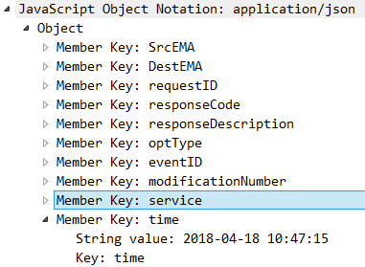
2. Smart Home Energy Framework : 2.2 EMAP(CoAP/JSON, MQTT/JSON) : Event-PULL,PUSH
파란색 : 기존 OpenADR Tag 부분
빨간색 : OpenADR확장된 Profile
초록색 : 삭제 또는 변경
(3) CretaedEvent
EMAP CoAP/JSON
Server EMA
192.168.1.127
Client EMA
192.168.1.101
(4) Response
(3) CreatedEvent
(4) Response
CreatedEvent Object{
“SrcEMA” : String,
“DestEMA” : String,
“requestID": String,
“responseCode": Integer,
“reponseDescription”: String,
“optType”: String,
“eventID” : String,
“modificationNumber” : Integer,
“service” : String,
“type” : String,
“time” : Date
}

Slide 145
2. Smart Home Energy Framework : 2.2 EMAP(CoAP/JSON, MQTT/JSON) : Event-PULL,PUSH
파란색 : 기존 OpenADR Tag 부분
빨간색 : OpenADR확장된 Profile
초록색 : 삭제 또는 변경
(3) CretaedEvent
EMAP CoAP/JSON
Server EMA
192.168.1.127
Client EMA
192.168.1.101
(4) Response
(3) CreatedEvent
(4) Response
Response Object{
“SrcEMA” : String,
“DestEMA” : String,
“requestID": String,
“responseCode” : Integer,
“responseDescription”: String,
“version": Integer=>삭제,
“service”: String,
“time” : Date
}

Slide 146
EMAP
(3) Event_PUSH
CoAP/JSON
MQTT / JSON

Slide 147
2. Smart Home Energy Framework : 2.2 EMAP(CoAP/JSON, MQTT/JSON) : Event-PULL, PUSH
파란색 : 기존 OpenADR Tag 부분
빨간색 : OpenADR확장된 Profile
(1) DistributeEvent
EMAP CoAP/JSON
Server EMA
(2) Response
Client EMA
(1) DistributeEvent
Key Name |  | Reference
 |  | OpenADR 2.0b |  | SEP 2.0(IEC 61968)
SrcEMA |  | ei:vtnID
DestEMA |  | ei:venID
requestID |  | ei:requestID
responseRequired |  | Ei:reponseRequired
response | requestID | ei:Response | pyld:requestID
 | responseCode |  | ei:responseCode
 | responseDescription |  | ei:responseDescription
event | eventID | oadrEvent:eiActivePeriod:eventDescriptor | eventID
 | eventSignals |  | eventSignals
 | modificationNumber |  | modificationNumber
 | modificationReason |  | modificationReason
 | priority |  | priority
 | marketContext |  | eiMarketContext
 | createdDateTime |  | createdDateTime
 | eventStatus |  | eventStatus
 | testEvent |  | testEvent
 | vtnComment |  | vtnComment
 | properties | oadrEvent:eiActivePeriod | properties
 | components |  | components
 | specificDestEMA | oadrEvent:eiTarget | venID
 | dtStart | oadrEvent:eiActivePeriod:properties | dtstart
 | Duration |  | duration
 | Tolerance |  | tolerance
 | notification |  | x-eiNotification
 | rampUp |  | x-eiRampUp
 | Recovery |  | x-eiRecovery
event:eventSignals | eventSignal | oadrEvent:eiEventSignals | eiEventSignal
 | intervals | oadrEvent:eiEventSignals:eiEventSignal | intervals
 | signalName |  | signalName
 | signalType (Price Event, Control Event, Reserve Mode, RealtimeDR) |  | signalType
 | signalID |  | signalID
 | currentValue |  | currentValue
 | threshold |  |  | IdentifiedObject:DemandResponseProgram:availabilityUpdatePowerChnageThreshold
 | capacity |  |  | AccountBalance:availableCredit
 | price |  |  | PriceResponseCgfObject
 | unit |  |  | CurrencyCodeObject
event:eventSignals:eventSignal:intervals | duration | oadrEvent:eiEventSignals:eiEventSignal:intervals:interval | duration
 | uid |  | uid
 | value |  | signalPayload
service |  | (Tag 이름으로 존재)
time |  |  |  | RandomizableEvent:creation Time
signalType으로 Price Event인지
Control Event, Reserve Mode, RealtimeDR인지 구분한다

Slide 148
2.2 EMAP(MQTT, CoAP/JSON) Service : EiEvent
EMAP
- EMA사이의 수요반응 통신 프로토콜이며 OpenADR 2.0b의 모델링을 따랐으며
일부 모델링을 확장했고 Discovery와 Monitoring, Control 부분의 통신 프로토콜이 확장.
Server EMA
(Client EMA)
EMAP
Client EMA
Session Setup(Registration)
Discovery
Opt
에너지관리에이전트 프로토콜의 Opt는 클라이언트 에너지관리에이전트가 상위 서버 에너지관리에이전트에게 수요반응 이벤트의 가용상태 또는 수요반응 이벤트 프로그램 변경, 수요반응 스케줄링을 요청을 알려주는 서비스.
Report
Monitoring
Demand Response Event
Control
Opt
Notes:
- SEP2.0 은 집안에서 운용되며, OpenADR 은 바운더리가 굉장히 넓다.
- SEP2.0 은 미터링등에 대한 정보를 OpenADR 을 통해서 ISO 나 에너지공급자에게 전달하며
- OpenADR 은 그것에 따른 과금,수요반응을 집안에 있는 디비이스에 SEP2.0을 통하여 전달한다. (양방향 통신)
그 데이터들은 인하우스디스플레이나 스마트폰을 통해서 사용자에게 전달된다.
- SEP2.0 은 집안의 HAN 상에서 디바이스들 끼리 커뮤케이션되게 해야한다.
- SEP2.0 은 커뮤티케이션 언어로 Restful Web 과 EXI 사용하며 , OpenADR 은 xml 기반이다.
따라서 SEP2.0 <--> OpenADR 간에 통신하기위해서는 언어매핑을 해줘야한다.
- SEP2.0 은 IP 기반이므로 Ethernet,WIFI 등을 지원한다. 그것에 맞추어 Zigbee IP 가 만들어졌고 Z/IP Z-wave 가 있다.
- SEP2.0 의 IP 기반의 HAN 상에서 mDNS 를 사용하여 서로를 감지한다.
- SEP2.0 을 준수하는 디바이스끼리는 SEP2.0 의 정해진 스펙(기능셋) 에 따라서 대화한다.
- SEP2.0 과 OpenADR 2 사이에 커뮤니케이션을 원할하게 하기위한 노력이 이루어지고있다.

Slide 149
2.2 EMAP(MQTT, CoAP/JSON) Service : Opt
VTN
OpenADR
HTTP/XML
VEN
Server EMA
EMAI Protocol
MQTT & COAP/JSON
Client EMA
(Server EMA)
GCON Protocol
Device
Opt
Original
OpenADR 2.0b
Opt
Extended
OpenADR
GCON Protocol
Session Setup
+ requestPower : double,
+ startYMD: Integer,
+ startTime: Integer,
+ endYMD: Integer,
+ endTime: Integer,
+ optStatus: String,
+ time : Date

Slide 150
EMAP
(4) Opt
CoAP/JSON
MQTT / JSON

Slide 151
2. Smart Home Energy Framework : 2.2 EMAP(CoAP/JSON, MQTT/JSON) : Schedule by using Opt
Server EMA
Client EMA 1
Client EMA 2
Client EMA 3
SEMA/1/oadrSchedule/CreateOpt
CEMA/1/oadrSchedule/CreatedOpt
SEMA/1/oadrSchedule/CreateOpt
CEMA/2/oadrSchedule/CreatedOpt
Create Schedule
SEMA/1/oadrSchedule/CreateOpt
CEMA/3/oadrSchedule/CreatedOpt
SEMA/1/oadrSchedule/CancelOpt
CEMA/3/oadrSchedule/CanceledOpt
Cancel Schedule that reserved

Slide 152
2.2 EMAP(CoAP/JSON) Service : Opt
Client EMA
Server EMA
PUT : /EMAP/SEMA/1.0b/Opt
Payload : CreateOpt
CreateOpt
PUT : 2.05 Content
Payload : CreatedOpt
PUT : /EMAP/SEMA/1.0b/Opt
Payload : CancelOpt
CancelOpt
PUT : 2.05 Content
Payload : CanceledOpt

Slide 153
2. Smart Home Energy Framework : 2.2 EMAP(CoAP/JSON, MQTT/JSON) : Schedule (Opt)
파란색 : 기존 OpenADR Tag 부분
빨간색 : OpenADR확장된 Profile
EMAP CoAP/JSON
(1) CreateOpt
Server EMA #
Client EMA #
(2) CreatedOpt
(1) CreateOpt
Key Name |  | Reference
 |  | OpenADR 2.0b |  | SEP 2.0(IEC 61968)
SrcEMA |  | ei:vtnID
DestEMA |  | ei:venID
optID |  | ei:qualifiedEventID
optType |  | ei:optType
optReason |  | ei:optReason
requestID |  | pyld:requestID
marketContext |  | ei:marektContext
createdDateTime |  | ei:createdDateTime
service |  | (Tag 이름으로 존재)
available | dtstart
 | duration |  |  | RandomizableEvent:randomizeDuration
 | requestPower | xcal :availability
 | startYMD |  |  | TimeObject:dstStartTime
 | startTime |  |  | TimeObject:dstStartTime
 | endYMD |  |  | TimeObject:dstEndTime
 | endTime |  |  | TimeObject:dstEndTime

Slide 154
2. Smart Home Energy Framework : 2.2 EMAP(CoAP/JSON, MQTT/JSON) : Schedule (Opt)
파란색 : 기존 OpenADR Tag 부분
빨간색 : OpenADR확장된 Profile
EMAP CoAP/JSON
(1) CreateOpt
Server EMA #
Client EMA #
(2) CreatedOpt
(2) CreatedOpt
Key Name | Reference
 | OpenADR 2.0b | SEP 2.0(IEC 61968)
SrcEMA | ei:vtnID
DestEMA | ei:venID
responseCode | ei:responseCode
responseDescription | ei:responseDescription
requestID | pyld:requestID
optID | ei:optID
optStatus |  | IdentifiedObject:TrafiiProfile:ServiceKind
service | (Tag 이름으로 존재)

Slide 155
2. Smart Home Energy Framework : 2.2 EMAP(CoAP/JSON, MQTT/JSON) : Schedule (Opt)
EMAP CoAP/JSON
(1) CreateOpt
Server EMA #
Client EMA #
(2) CreatedOpt
(1) CreateOpt
(2) CreatedOpt
Key name |  | Comments
SrcEMA |  | source EMA identifier
DestEMA |  | destination EMA identifier
optID |  | opt identifier
optType |  | type of opt
optReason |  | opt reason(e.g. emergency)
marketContext |  | refer market address
available | dtstart | opt start time
 | duration | opt duration
 | requestPower | opt 요청 전력량
 | startYMD | opt start date
 | startTime | opt start time
 | endYMD | opt end date
 | endTime | opt end time
requestID |  | request identifier
service |  | type of service
Key name | Comments
SrcEMA | source EMA identifier
DestEMA | destination EMA identifier
requestID | request identifier
responseCode | response code
responseDescription | description of response code
optID | opt identifier
service | type of service
optStatus

Slide 156
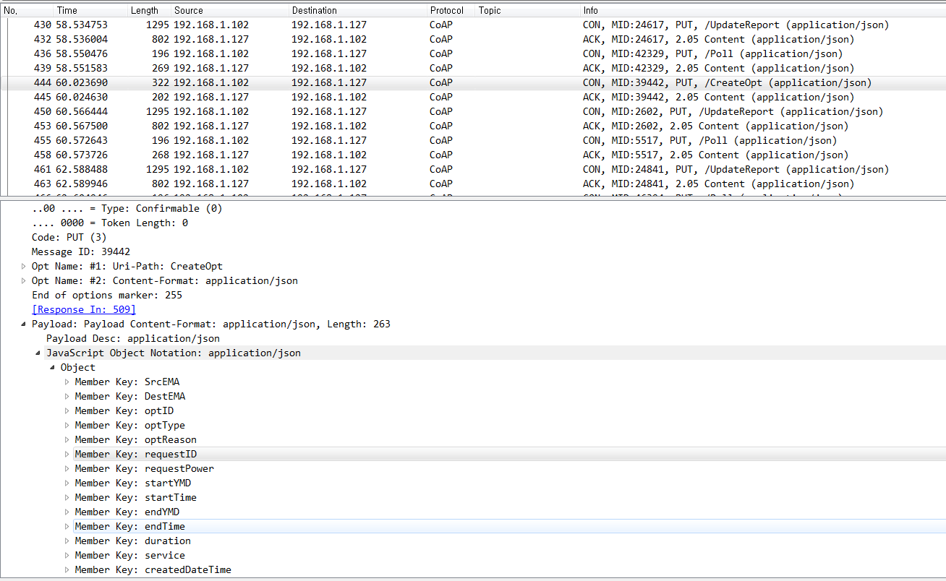
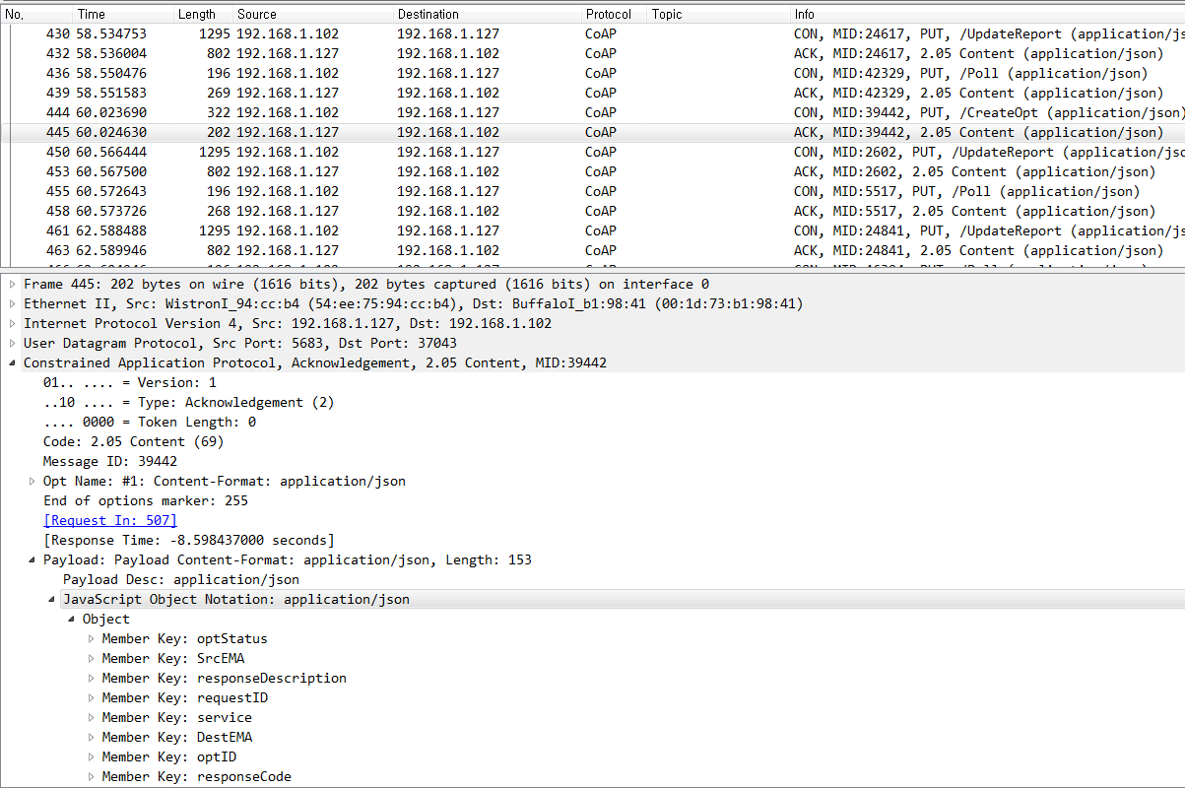
2. Smart Home Energy Framework : 2.2 EMAP(CoAP/JSON, MQTT/JSON) : Schedule (Opt)
파란색 : 기존 OpenADR Tag 부분
빨간색 : OpenADR확장된 Profile
초록색 : 삭제 또는 변경
EMAP CoAP/JSON
(1) CreateOpt
Server EMA #
Client EMA #
(2) CreatedOpt
(1) CreateOpt
(2) CreatedOpt
CreateOpt Object{
“SrcEMA” : String,
“DestEMA” : String,
“optID”: String,
“optType”: String,
“optReason”: String,
“requestID” : String,
“marketContext” : String,
“createdDateTime”: Date,
“service” : String,
“available” : Array,
}
available Array{
“dtstart” : Date,
“duration” : String,
“requestPower” : double,
“startYMD”: Integer,
“startTime”: Integer,
“endYMD”: Integer,
“endTime”: Integer,
}
CreatedOpt Object{
“SrcEMA” : String,
“DestEMA” : String,
“optID”: String,
“requestID”: String,
“responseCode”: Integer,
“responseDescription” : String,
“service” : String,
“optStatus”: String
}
*optStatus: Accept, Reject

Slide 157
2. Smart Home Energy Framework : 2.2 EMAP(CoAP/JSON, MQTT/JSON) : Schedule _CancelOpt
파란색 : 기존 OpenADR Tag 부분
빨간색 : OpenADR확장된 Profile
EMAP CoAP/JSON
(1) CancelOpt
Server EMA #
Client EMA #
(2) CanceledOpt
(1) CancelOpt
Key Name | Reference
 | OpenADR 2.0b | SEP 2.0(IEC 61968)
SrcEMA | ei:vtnID
DestEMA | ei:venID
requestID | pyld:requestID
optID | ei:OptID
time |  | RandomizableEvent:creation Time
service | (Tag 이름으로 존재)
(2) CanceledOpt
Key Name | Reference
 | OpenADR 2.0b | SEP 2.0(IEC 61968)
SrcEMA | ei:vtnID
DestEMA | ei:venID
responseCode | Ei:responseCode
responseDescription | ei:responseDescription
requestID | Pyld:requestID
optID | ei:optID
service | (Tag 이름으로 존재)

Slide 158
2. Smart Home Energy Framework : 2.2 EMAP(CoAP/JSON, MQTT/JSON) : Schedule _CancelOpt
EMAP CoAP/JSON
(1) CancelOpt
Server EMA #
Client EMA #
(2) CanceledOpt
(1) CancelOpt
(2) CanceledOpt
Key name | Comments
SrcEMA | source EMA identifier
DestEMA | destination EMA identifier
requestID | request identifier
optID | opt identifier
service | type of service
time | service creation time
Key name | Comments
SrcEMA | source EMA identifier
DestEMA | destination EMA identifier
requestID | request identifier
responseCode | response code
responseDescription | description of response code
optID | opt identifier
service | type of service

Slide 159
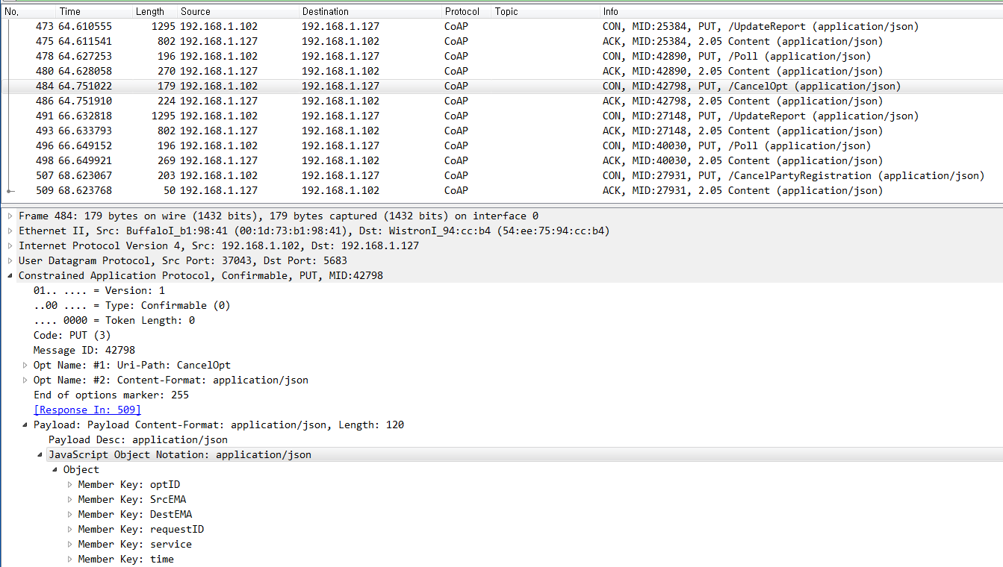
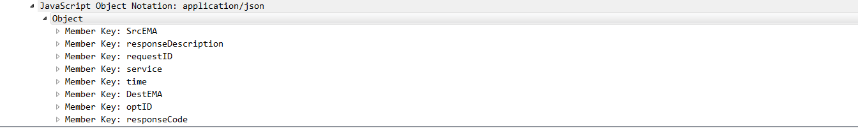
2. Smart Home Energy Framework : 2.2 EMAP(CoAP/JSON, MQTT/JSON) : Schedule _CancelOpt
파란색 : 기존 OpenADR Tag 부분
빨간색 : OpenADR확장된 Profile
초록색 : 삭제 또는 변경
EMAP CoAP/JSON
(1) CancelOpt
Server EMA #
Client EMA #
(2) CanceledOpt
CancelOpt
CanceledOpt
CancelOpt JSONObject{
“optID”: String,
“SrcEMA” : String,
“DestEMA” : String,
“requestID”: String,
“service” : String
“time”: Date
}
CanceledOpt Object{
“optID”: String,
“SrcEMA” : String,
“DestEMA” : String,
“requestID”: String,
“responseCode”: Integer,
“responseDescription” : String,
“service”: String
}

Slide 160
2. Smart Home Energy Framework : 2.2 EMAP(CoAP/JSON, MQTT/JSON) : Event-PULL, PUSH
파란색 : 기존 OpenADR Tag 부분
빨간색 : OpenADR확장된 Profile
(1) DistributeEvent
EMAP CoAP/JSON
Server EMA
(2) Response
Client EMA
(2) Response
Key Name | Reference
 | OpenADR 2.0b |  | SEP 2.0(IEC 61968)
SrcEMA | ei:vtnID
DestEMA | ei:venID
responseCode | ei:eiResponse | ei:responseCode
responseDescription |  | ei:responseDescription
requestID |  | Pyld:requestID
service | (Tag 이름으로 존재)
type |  |  | TariffProfile:serviceCategoryKind:ServiceKind
time |  |  | RandomizableEvent:creationTime

Slide 161
2. Smart Home Energy Framework : 2.2 EMAP(CoAP/JSON, MQTT/JSON) : Event-PULL, PUSH
(1) DistributeEvent
EMAP CoAP/JSON
Server EMA
(2) Response
Client EMA
(1) DistributeEvent
Key name |  |  |  | Comments
SrcEMA |  |  |  | source EMA identifier
DestEMA |  |  |  | destination EMA identifier
response | requestID |  |  | request identifier
 | responseCode |  |  | response code
 | responseDescription |  |  | description of response code
event | eventID |  |  | event identifier
 | eventSiganls | intervals | duration | event signal interval duration
 |  |  | uid | event user id
 |  |  | value | event value
 |  | signalName |  | event signal name
 |  | signalType |  | event signal type (bi direct, level)
 |  | signalID |  | event signal ID
 |  | currentValue |  | current usage value
 |  | threshold |  | available amount of energy
 |  | capacity |  | 사용 가능량 (threshold - power)
 |  | price |  | price of energy
 |  | unit |  | 단위
 | modificationNumber |  |  | modification Number(count)
 | modificationReason |  |  | modification reason(event reason)
 | priority |  |  | priority
 | marketContext |  |  | market address(market reference)
 | createdDateTime |  |  | event create date & time
 | eventStatus |  |  | event status
 | testEvent |  |  | if event test or not
 | vtnComment
 | dtStart |  |  | event start time
 | duration |  |  | event duration
 | properties
 | components
 | specificDestEMA |  |  | specific target EMA
 | tolerance |  |  | tolerance duration
 | notification |  |  | notification duration
 | rampUp |  |  | ramp up duration
 | recovery
responseRequired |  |  |  | response mandatory or not
service |  |  |  | type of service
time |  |  |  | service creation time

Slide 162
2. Smart Home Energy Framework : 2.2 EMAP(CoAP/JSON, MQTT/JSON) : Event-PULL, PUSH
(1) DistributeEvent
EMAP CoAP/JSON
Server EMA
(2) Response
Client EMA
(2) Response
Key name | Comments
SrcEMA | source EMA identifier
DestEMA | destination EMA identifier
requestID | request identifier
responseCode | response code
responseDescription | description of response code
service | type of service
time | service creation time

Slide 163
2. Smart Home Energy Framework : 2.2 EMAP(CoAP/JSON, MQTT/JSON) : Event-PULL, PUSH
파란색 : 기존 OpenADR Tag 부분
빨간색 : OpenADR확장된 Profile
초록색 : 삭제 또는 변경
EMAP CoAP/JSON
(1) DistributeEvent
Server EMA
(2) Response
Client EMA
(1) DistributeEvent
DistributeEvent Object{
“SrcEMA” : String,
“DestEMA” : String,
“requestID” : String,
“response” : Array,
“event” : Array,
“responseRequired” : String,
“service” : String,
“time” : Date
}
event Array{
“eventID” : String,
“eventSignals” : Array,
“modificationNumber” : Integer,
“modificationReason” : String,
“priority” : Integer,
“marketContext” : String,
“createdDataTime” : Date,
“eventStatus” : String,
“testEvent” : Boolean,
“vtnComment” : String,
“dtstart” : Date,
“duration” : String,
“properties” : String,
“components” : String,
“specificDestEMA” : String,
“tolerance” : String,
“notification” : String,
“rampUp” : String,
“recovery” : String
}
eventSignals Object{
“eventSignal” : String,
“intervals” : Array,
“signalName” : String,
“signalType” : String, (Price Event, Control Event, Reserve
Mode, RealtimeDR인지 구분)
“signalID” : String,
“currentValue” : Double,
“threshold” : Double,
“capacity” : Double,
“price” : Integer,
“unit” : String,
}
response Array{
“requestID” : String,
“responseCode” : Integer,
“responseDescription” : String
}
intervals Array{
“duration” : String,
“uid” : Integer,
“value” : Double
}

Slide 164
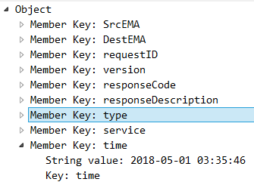
2. Smart Home Energy Framework : 2.2 EMAP(CoAP/JSON, MQTT/JSON) : Event-PULL, PUSH
파란색 : 기존 OpenADR Tag 부분
빨간색 : OpenADR확장된 Profile
초록색 : 삭제 또는 변경
(1) DistributeEvent
EMAP CoAP/JSON
Server EMA
(2) Response
Client EMA
(2) Response
Response Object{
“SrcEMA” : String,
“DestEMA” : String,
“requestID": String,
“responseCode” : Integer,
“responseDescription”: String,
“service” : String,
“type": String,
“time” : Date
}
type : Registration ,Periodic , report, Event, Price인지 구분

Slide 165
2. Smart Home Energy Framework : 2.2 EMAP(CoAP/JSON, MQTT/JSON) : Event-PULL, PUSH
파란색 : 기존 OpenADR Tag 부분
빨간색 : OpenADR확장된 Profile
(3) CreatedEvent
EMAP CoAP/JSON
Server EMA
(4) Response
Client EMA
(3) CreatedEvent
Key Name | Reference
 | OpenADR 2.0b |  | SEP 2.0(IEC 61968)
SrcMEA | ei:venID
DestEMA | ei:vtnID
responseCode | ei:eiResponse | Ei:responseCode
responseDescription |  | ei:responseDescription
optType | ei:eventResponse | ei:optType
eventID |  | ei:eventID
modificationNumber |  | ei:modificationNumber
requestID |  | pyld:requestID
service | (Tag 이름으로 존재)
time |  |  | RandomizableEvent:creation Time

Slide 166
2. Smart Home Energy Framework : 2.2 EMAP(CoAP/JSON, MQTT/JSON) : Event-PULL, PUSH
파란색 : 기존 OpenADR Tag 부분
빨간색 : OpenADR확장된 Profile
(3) CreatedEvent
EMAP CoAP/JSON
Server EMA
(4) Response
Client EMA
(4)Response
Key Name | Reference
 | OpenADR 2.0b |  | SEP 2.0(IEC 61968)
SrcEMA | ei:vtnID
DestEMA | ei:venID
responseCode | ei:eiResponse | ei:responseCode
responseDescription |  | ei:responseDescription
requestID |  | Pyld:requestID
service | (Tag 이름으로 존재)
type |  |  | TariffProfile:serviceCategoryKind:ServiceKind
time |  |  | RandomizableEvent:creationTime

Slide 167
2. Smart Home Energy Framework : 2.2 EMAP(CoAP/JSON, MQTT/JSON) : Event-PULL, PUSH
(3) CreatedEvent
EMAP CoAP/JSON
Server EMA
(4) Response
Client EMA
(3) CreatedEvent
(4)Response
Key name | Comments
SrcEMA | source EMA identifier
DestEMA | destination EMA identifier
requestID | request identifier
responseCode | response code
responseDescription | description of response code
eventID | Event identifier
modificationNumber | modification number(count)
optType | if paticipate event or not
service | type of service
time | service creation time
Key name | Comments
SrcEMA | source EMA identifier
DestEMA | destination EMA identifier
requestID | request identifier
responseCode | response code
responseDescription | description of response code
service | type of service
time | service creation time

Slide 168
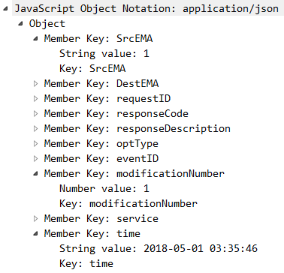
2. Smart Home Energy Framework : 2.2 EMAP(CoAP/JSON, MQTT/JSON) : Event-PULL, PUSH
파란색 : 기존 OpenADR Tag 부분
빨간색 : OpenADR확장된 Profile
초록색 : 삭제 또는 변경
EMAP CoAP/JSON
(3) CreatedEvent
Server EMA
(4) Response
Client EMA
(3) CreatedEvent
(4) Response
CreatedEvent Object{
“SrcEMA” : String,
“DestEMA” : String,
“requestID": String,
“responseCode": Integer,
“reponseDescription”: String,
“optType”: String,
“eventID” : String,
“modificationNumber” : Integer,
“service” : String,
“time” : Date
}

Slide 169
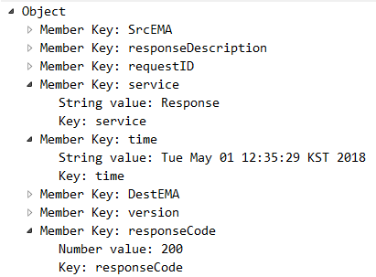
2. Smart Home Energy Framework : 2.2 EMAP(CoAP/JSON, MQTT/JSON) : Event-PULL, PUSH
파란색 : 기존 OpenADR Tag 부분
빨간색 : OpenADR확장된 Profile
초록색 : 삭제 또는 변경
EMAP CoAP/JSON
(3) CreatedEvent
Server EMA
(4) Response
Client EMA
(3) CreatedEvent
(4) Response
Response Object{
“SrcEMA” : String,
“DestEMA” : String,
“requestID": String,
“responseCode” : Integer,
“responseDescription”: String,
“service”: String,
“type": String,
“time” : Date
}

Slide 170
Appendix
Java Thread Management
Smart Meter : Periodical On Demand Request

Slide 171
Java Thread Management
JButton btnNewButton = new JButton("SET");
btnNewButton.setBounds(556, 242, 62, 23);
add(btnNewButton);
btnNewButton.addActionListener(new ActionListener() {
@Override
public void actionPerformed(ActionEvent e) {
if (global.onDemandCNT > 0) {
Thread[] ee = new Thread[10000];
Thread.enumerate(ee); 현재 실행되고 있는 Thread List를 Thread 배열에 저장한다
for (int i = 0; i < ee.length; i++) {
if (ee[i].getName().equals("onDemand")) { Thread 배열에 ‘onDemand’ 라는 이름인 Thread를 검색한다.
ee[i].interrupt(); 해당 Thread가 있을 경우 Interrupt 명령어를 통해 종료한다.
break; 검색 시간을 줄이기 위해 break;
} else { Stop 이라는 명령어를 쓰는 것 보다 수행하는 Thread Class에 Interrupt Option 을 걸어 주는 것이 효율 적인 Thread 관리 방법
}
}
}
int sec = Integer.parseInt(textField.getText()) * 1000;
RunnableJob onDemandInterval = new RunnableJob(sec);
Thread onDemandRequest = new Thread(onDemandInterval);
onDemandRequest.setName("onDemand");
onDemandRequest.start();
global.onDemandCNT += 1;
}
});

Slide 172
Java Thread management
public class RunnableJob implements Runnable {
public int intervalTime = 1000;
public RunnableJob(int interval) {
this.intervalTime = interval;
}
@Override
public void run() {
try {
while (!Thread.classurrentThread().isInterrupted()) { Thread.isInterrupt()이 아니라 현재 수행 중인 Thread를 종료하는 코드
long sTime = System.classurrentTimeMillis();
Thread.sleep(intervalTime);
long cTime = System.classurrentTimeMillis();
long rTime = cTime - sTime;
System.out.println(rTime / 1000 + "초");
Object[] dcuList = global.dcuHashMap.keySet().toArray();
for (int i = 0; i < dcuList.length; i++) {
System.out.println(global.dcuHashMap.get(dcuList[i]).toString());
String[] parseRemoteIp = global.dcuHashMap.get(dcuList[i].toString()).toString().split("/");
String remoteIp = parseRemoteIp[0];
String dcuId = parseRemoteIp[1];
String meterId = parseRemoteIp[4];
JSONArray meterList = global.dcuHashMap.get(dcuList[i]).getMeterInfo();
for (int j = 0; j < meterList.size(); j++) {
JSONArray meterIDarr = new JSONArray();
meterIDarr.add(meterList.get(j));
TcpClient tcpClient = new TcpClient(remoteIp, dcuId, meterIDarr, "ondemand");
tcpClient.start();
}
}
}
} catch (InterruptedException e) {
e.printStackTrace();
} finally {
System.out.println("OnDemand Thread is Dead");
}
}
}

Slide 173
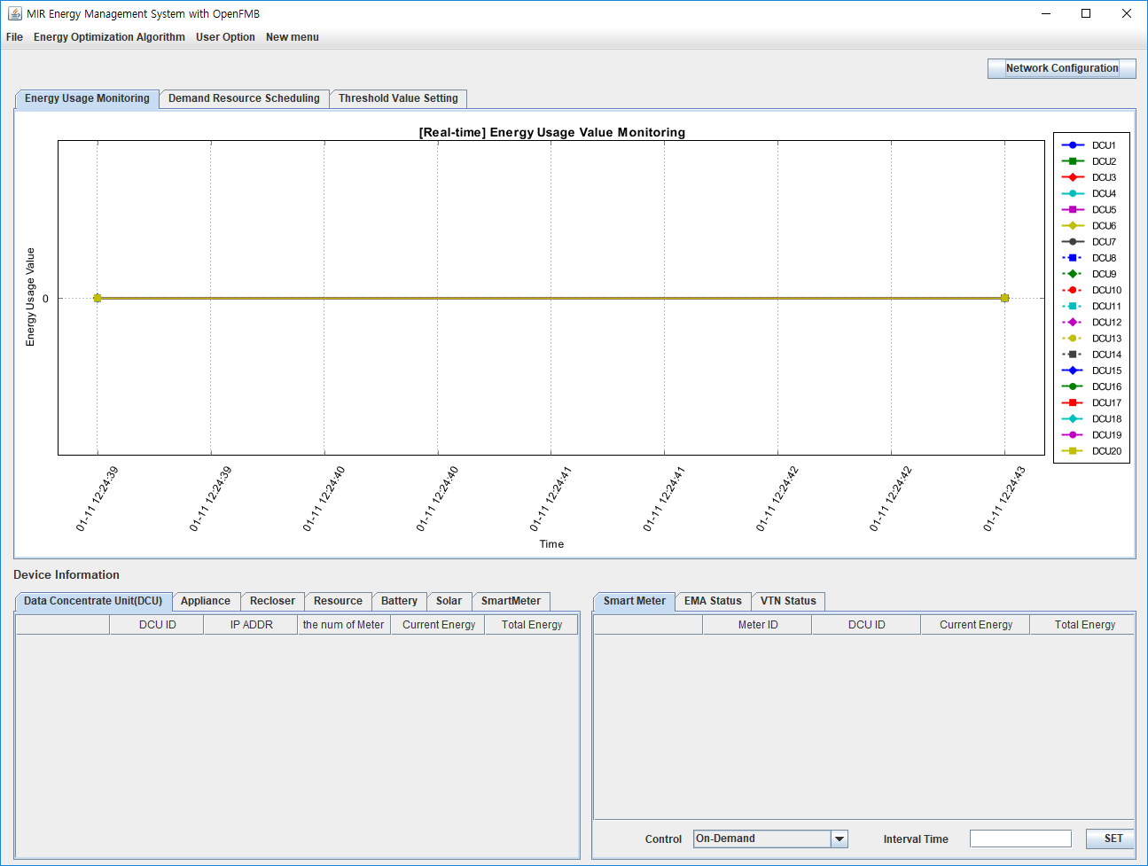
수정 된 사항
목적:
Data Traffic & Event Response 실험을 위해
On-Demand Interval Time을 설정 할 수 있다.
기존 문제점:
기존에는 ‘SET’ 버튼을 누를 때 마다
Thread가 추가적으로 생성된다.
해결방법:
Thread Interrupt 함수를 이용하여
보다 효과적으로 Thread를 관리한다.

